Slide 1
Corporate Social Responsibility in Health Management
Lecturer Maria A. Caratas PhD.
Law and Administrative Sciences Faculty
Ovidius University of Constanta, Romania

Slide 2
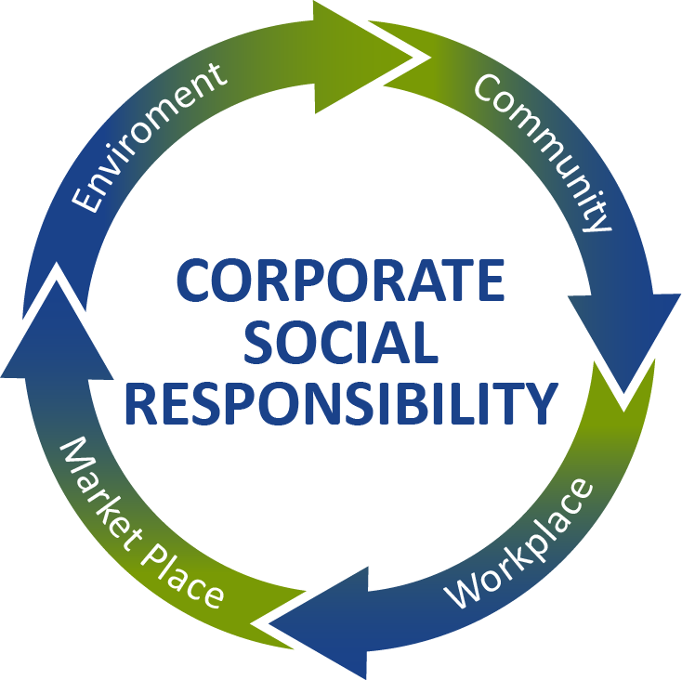
Corporate social responsibility
The European Commission defines corporate social responsibility (CSR) as “a process to integrate social, environmental, ethical, human rights and consumer concerns into their business operations and core strategy in close collaboration with their stakeholders, with the aim of maximizing the creation of shared value for their owners/shareholders and civil society at large and identifying, preventing and mitigating possible adverse impacts”.
We cannot see separately the words “corporate/company” and “social/society”.
In this respect, CSR covers the responsibilities that companies have to societies within they operate.

Slide 4
Introduction to CSR in Healthcare
Corporate Social Responsibility (CSR) is increasingly recognized as a significant factor in the health management sector.
It encompasses the ethical obligations and initiatives taken by healthcare organizations to improve the community's health outcomes, environmental sustainability, and social well-being.

Slide 5
1. Ethical Considerations
Patient-Centric Care - CSR ensures that healthcare providers prioritize patient well-being over profitability, aligning with ethical staandards of care.
Equity in Access - Ethically, CSR commits to equitable access to healthcare services, regardless of patients' socioeconomic status.
Transparency - Through CSR, healthcare entities maintain transparent operations, fostering trust with patients and stakeholders.

Slide 6
2. Impact on Patient Outcomes
Quality of Care: Healthcare providers engaged in CSR often invest in better facilities and training, directly improving patient care quality.
Innovation: CSR-driven organizations are motivated to invest in research and development, leading to innovative treatments that enhance patient outcomes.

Slide 7
3. Impact on Public Health
Health Education: CSR initiatives often include community outreach and education, which can lead to more informed health choices and better public health.
Preventive Care: By focusing on preventive measures, CSR can help reduce the incidence of diseases and the overall burden on the healthcare system.
Environmental Health: CSR in health management also involves reducing the environmental impact of healthcare operations, which is crucial for public health.

Slide 8
4. Community and Stakeholder Engagement
CSR activities can build stronger community relationships, which is essential for understanding and addressing local health issues.
Stakeholders, including investors and employees, are increasingly valuing CSR, seeing it as indicative of a company's long-term viability and ethical standing.

Slide 9
5. Economic Benefits
CSR can also lead to economic benefits for healthcare organizations by enhancing their reputation, leading to increased patient trust and, consequently, a larger patient base.
Ethical business practices can attract better talent and more investments, contributing to a more robust healthcare system.

Slide 10
CSR is not just a moral imperative but a strategic asset in health management.
It aligns the goals of healthcare providers with the needs of patients and the wider community, fostering a holistic approach to health and well-being.
Engaging in CSR is also a forward-thinking stance for healthcare organizations, which can lead to improved patient outcomes, enhanced public health, and a positive social impact, all while supporting sustainable business practices.

Slide 11
Sustainability and Governance in Healthcare
Part 2

Slide 12
Overview of Sustainable Healthcare Practices
Sustainable healthcare practices are those that seek to minimize the environmental impact of healthcare delivery while promoting health and well-being. Key aspects include:
Waste Reduction: Implementing recycling programs, reducing packaging, and managing hazardous waste properly to minimize environmental pollution.
Energy Efficiency: Upgrading to energy-efficient lighting and machinery, and utilizing renewable energy sources to decrease carbon footprint.
Sustainable Sourcing: Procuring medical supplies and pharmaceuticals that are produced sustainably and ethically.
Water Conservation: Installing water-saving devices and managing water use responsibly to preserve this vital resource.

Slide 13
Overview of Sustainable Healthcare Practices
Green Building Design: Constructing new facilities and renovating existing ones to be more energy-efficient and environmentally friendly.
Telemedicine: Using telehealth technologies to reduce the need for patient travel, thus cutting down on emissions related to transportation.
Education and Training: Ensuring that healthcare professionals are educated about sustainability and its importance in health care.
These practices contribute to a healthier environment, which is intrinsically linked to public health. They also tend to generate long-term cost savings for healthcare facilities.

Slide 14
Integrating CSR into Health Facility Governance and Policy-Making
Integrating CSR into governance and policy-making involves a strategic approach to ensure that CSR becomes an integral part of health facility operations. Steps include:
Policy Development: Creating policies that reflect the commitment to CSR, including ethical patient care, environmental protection, and community engagement.
Leadership Commitment: Ensuring that the leadership team not only endorses CSR initiatives but actively promotes and participates in them.
Stakeholder Involvement: Engaging with patients, staff, suppliers, and the community to gather insights and feedback on CSR priorities and performance.
Performance Metrics: Establishing clear CSR goals and performance metrics to measure and report on progress.

Slide 15
Integrating CSR into Health Facility Governance and Policy-Making
Training and Culture: Incorporating CSR values into staff training and organizational culture to ensure that all levels of the organization understand and support CSR.
Reporting and Transparency: Implementing transparent reporting mechanisms to communicate CSR efforts and outcomes to stakeholders and the public.
Continuous Improvement: Regularly reviewing policies, practices, and outcomes to identify areas for improvement and innovation in CSR.
By integrating CSR principles into the core governance and policy-making processes, healthcare facilities can ensure that their operations support both the well-being of patients and the health of the environment. This integration also helps to position healthcare facilities as responsible and responsive members of the community, which can enhance their reputation and the trust they receive from the public.

Slide 16
Environmental, Social, and Governance (ESG) Factors in Healthcare
Part 3

Slide 17
Environmental (E):
Resource Management: Efficient use of water, energy, and other resources in healthcare facilities.
Waste Disposal: Proper disposal and reduction of medical and hazardous waste.
Sustainable Procurement: Purchasing eco-friendly and ethically sourced medical supplies.
Pollution Control: Measures to prevent air, water, and soil pollution from healthcare operations.
Carbon Footprint: Initiatives to measure, report, and reduce greenhouse gas emissions.
This Photo by Unknown author is licensed under CC BY.

Slide 18
Social (S)
Access to Care: Ensuring equitable access to healthcare services for all sections of society.
Patient Privacy and Data Security: Protecting sensitive patient information and ensuring confidentiality.
Community Engagement: Outreach programs and partnerships that promote public health.
Employee Well-being: Providing a safe and healthy work environment for healthcare professionals.
Health and Safety: Protocols to ensure the safety of patients and staff within healthcare facilities.
This Photo by Unknown author is licensed under CC BY-SA.

Slide 19
Governance (G)
Compliance: Adherence to healthcare regulations, laws, and ethical standards.
Board Diversity: Promoting a diverse leadership that represents the demographics of the patient population.
Transparency: Open reporting and disclosure of operational practices and outcomes.
Risk Management: Policies for managing financial, clinical, and operational risks.
Stakeholder Engagement: Involving various stakeholders in decision-making processes.

Slide 20
Case Studies

Slide 21
Objective: Evaluate how environmental, social, and governance (ESG) considerations affect the decision-making process in a healthcare setting.
Case Study 1: Community Health Improvement Initiative
Organization: Midsize Regional Hospital
CSR Focus: Improving community health outcomes and access to care
Background: The hospital identified high rates of chronic diseases within the local community, with many cases going untreated due to lack of awareness and limited access to healthcare services.

Slide 22
CSR Initiative: The hospital launched a "Community Health Improvement Program" (CHIP), which included:
- Free health screening camps in underserved areas.
- Educational workshops on chronic disease management.
- Partnership with local schools to promote health education.
Outcomes:
- Increased community awareness of chronic diseases.
- Early detection of chronic health issues leading to better outcomes.
- Strengthened relationship with the community, enhancing the hospital’s reputation.
Lessons Learned: CSR programs that address direct community needs can improve public health while also building the organization's social capital.

Slide 23
Case Study 2: Environmental Sustainability in Healthcare
Organization: Large Healthcare System
CSR Focus: Environmental sustainability in healthcare operations
Background: The healthcare system recognized the significant environmental impact of its operations, including waste production and energy consumption.
CSR Initiative: Implementation of a "Green Health Initiative" (GHI) that involved:
- Reducing medical waste through better sorting and recycling programs.
- Investing in energy-efficient technologies across its facilities.
- Sourcing supplies from sustainable and ethical vendors.

Slide 24
Outcomes:
- Reduction in waste production by 30% in the first year.
- Decreased energy consumption and lower operational costs.
Improved brand image as a leader in environmental responsibility.
Lessons Learned:
Sustainable practices in healthcare can lead to cost savings, environmental benefits, and improved stakeholder trust.

Slide 25
Implementing CSR Initiatives in Health Settings
Part 4

Slide 26
Case studies highlighting effective CSR strategies in healthcare
Energy Efficiency in Hospitals
Turkey has been working on improving the energy efficiency of its hospitals.
With the support of international funding, such as from the European Bank for Reconstruction and Development (EBRD), several hospitals have been upgraded to use less energy and water, reducing their environmental impact.
The EBRD is a leading institutional investor in Türkiye. Since 2009, the Bank has invested over €17,2 billion in various sectors of the country’s economy, with almost all investment in the private sector. The EBRD’s €7.3 billion Türkiye portfolio is the largest among the 38 economies where the Bank invests.

Slide 27
The European Bank for Reconstruction and Development (EBRD) has provided a €75 million loan to Rönesans Saglik Yatirim A.S., a subsidiary of Rönesans Holding in Turkey, to invest in hospital infrastructure through public-private partnership (PPP).
This investment supports the completion of hospital projects with a focus on sustainability and social infrastructure development. Rönesans is working on five hospital projects, aiming to achieve a total capacity of 9,000 beds upon completion.
The EBRD funding prioritizes advancements in corporate governance and climate-risk management. The loan will enable Rönesans to implement a comprehensive action plan, including achieving LEED certification for all current and new hospital investments.
LEED-certified buildings enhance water efficiency, energy use, and environmental quality, leading to a reduction in Scope 3 emissions. The cooperation with EBRD also includes piloting practical guidelines on gender-based violence and harassment, reflecting a commitment to social responsibility alongside environmental sustainability
https://www.ebrd.com/news/2022/ebrd-financing-to-support-hospital-infrastructure-in-trkiye-.html

Slide 28
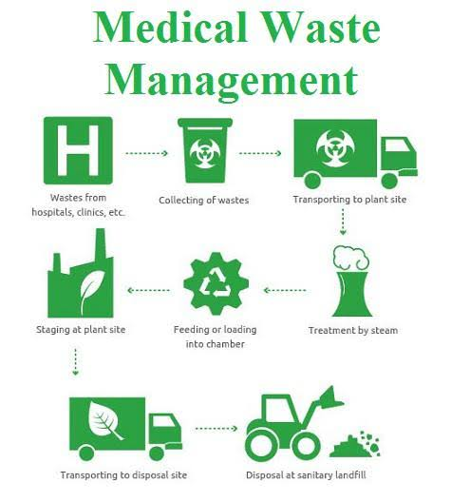
Medical Waste Management
The Turkish Ministry of Environment and Urbanization has developed regulations and guidelines for the management of medical waste.
Hospitals and other healthcare facilities have adopted these guidelines to ensure that medical waste is handled and disposed of in an environmentally safe manner.

Slide 29
Green Hospital Certification
Some hospitals in Turkey are pursuing Green Hospital Certification, which requires them to meet certain criteria in terms of energy efficiency, waste management, and the creation of a healthy environment for patients and staff.
These certifications are in line with international standards and are indicative of a broader commitment to sustainability.
This Photo by Unknown author is licensed under CC BY-NC.

Slide 30
Use of Renewable Energy
There is an increasing trend among healthcare facilities in Turkey to invest in renewable energy sources, such as solar and wind power, to power their operations.
This not only helps to reduce greenhouse gas emissions but also secures energy independence and resilience for these critical facilities.

Slide 31
Training and Education
Turkish healthcare providers are also focusing on training their staff in sustainable practices. This includes educating them on energy conservation, waste reduction, and the importance of sustainability in healthcare settings.

Slide 32
Green Procurement
In line with global practices, there is a movement towards green procurement in Turkish healthcare, where hospitals source materials and supplies that are environmentally friendly, from the chemicals used in cleaning to the food provided to patients.
While these are some of the sustainability practices observed in Turkey's healthcare system, the extent and effectiveness of these initiatives can vary widely among different institutions.
As the global emphasis on sustainability continues to grow, it is likely that such practices will become more standardized and widespread throughout the country's healthcare sector.

Slide 33
Real-world examples of sustainability practices in healthcare organizations:
Reducing Carbon Footprint in Hospitals
Organization: Kaiser Permanente
Sustainability Practice: Kaiser Permanente, one of the largest healthcare providers in the U.S., has made significant strides in reducing its carbon footprint.
It has achieved carbon-neutral status by implementing energy efficiency measures, investing in renewable energy, and purchasing carbon credits. The organization has also committed to becoming carbon positive, generating more renewable energy than it uses.
This Photo by Unknown author is licensed under CC BY-SA.

Slide 34
Sustainable Healthcare Waste Management
Organization: Practice Greenhealth Members
Sustainability Practice
Practice Greenhealth is an organization that provides resources for hospitals and health systems to improve their environmental stewardship.
Its member organizations have adopted comprehensive waste management programs, which include aggressive recycling efforts, reprocessing of single-use medical devices, and proper segregation to reduce regulated medical waste.

Slide 35
Green Building for Health Facilities
Organization: Gundersen Health System
Sustainability Practice
Gundersen Health System has been a leader in sustainable healthcare by constructing and retrofitting buildings to meet high environmental standards.
They achieved energy independence in 2014 through a combination of energy conservation efforts and investments in renewable energy projects such as wind farms, biomass boilers, and solar panels.

Slide 36
Sustainable Sourcing and Procurement
Organization: Cleveland Clinic
Sustainability Practice
Cleveland Clinic has focused on sustainable sourcing by prioritizing the purchase of local and sustainable food.
Their food service operations focus on buying local produce, which reduces transportation emissions, supports the local economy, and provides patients and staff with fresher food options.

Slide 37
Water Conservation and Management
Organization: Stanford Health Care
Sustainability Practice
Stanford Health Care has implemented extensive water conservation measures, including the installation of low-flow fixtures, efficient sterilization processes for medical equipment, and water-efficient landscaping.
These efforts not only conserve water but also reduce the facility's operating costs.

Slide 38
Romania's Healthcare Sustainability Practices
1. Energy Efficient Hospital Buildings:
- Romania has seen investments in making hospital buildings more energy-efficient, often supported by European Union funds. This includes better insulation, modern heating systems, and energy-efficient lighting systems.
2. Green Hospital Framework:
- The "Green Hospital" concept is gaining traction, where Romanian hospitals are encouraged to reduce waste, lower energy consumption, and implement more sustainable procurement policies.
3. Medical Waste Management:
- Enhanced protocols for medical waste management have been implemented, ensuring safe and environmentally friendly disposal and treatment, following both national regulations and EU directives.

Slide 39
Broader European Healthcare Sustainability Practices

Slide 40
1. Net-Zero Hospitals: In the UK, the NHS has set out a plan to become the world’s first net-zero national health service. This involves a range of actions, including reducing carbon emissions, greener hospital builds, and sustainable travel options for staff and patients.
2. Sustainable Procurement: Many European countries have introduced sustainable procurement policies within healthcare systems. This includes buying eco-friendly products, sourcing food locally, and using medical devices that are reusable or have a lower environmental impact.
3. Pharmaceutical Pollution Control: Countries like Sweden are leading efforts to minimize pharmaceutical pollution by enhancing drug disposal methods and encouraging the development of eco-friendlier pharmaceuticals.

Slide 41
4. Digital Health Records:
- Across Europe, the shift to digital health records is reducing the need for paper, thereby saving trees and reducing waste. It also enhances efficiency in the healthcare system.
5. Sustainable Food Services:
- Hospitals in countries like France and Italy offer organic and locally-sourced food to patients and staff, supporting local agriculture and reducing carbon emissions related to transportation.
6. Alternative Energy Sources:
- Some German hospitals are using alternative energy sources such as solar panels, geothermal energy, and biomass for heating and electricity, reducing reliance on fossil fuels.
7. Transportation:
- Denmark and the Netherlands encourage the use of bicycles for hospital staff and visitors by providing bicycle parking and shower facilities, thereby reducing traffic and emissions.

Slide 42
Synthesis and Q&A
- Recap of key takeaways.
- Open floor for questions, ensuring clarity and readiness to apply CSR concepts.
contact: maria.caratas@365.univ-ovidius.ro
LinkedIn

