Slide 1
Akademik Etik Uygulama ve Araştırma Merkezi: 2023 Yılı Faaliyetleri

Slide 2
Projeler

Slide 3
“Akademik Dürüstlük Tehditleriyle Yüzleşme” Projesi (FAITH): Proje Yürütücüsü
https://faithproject.info/
Fonlayıcı: Türkiye Ulusal Ajansı Erasmus+ programı KA220-HED - Yükseköğretimde işbirliği ortaklıkları eylemi
Bütçe: 274.709 avro
Süre: 3 yıl (2021 – 2024 yılları arasında)
Amaç: Proje temel olarak akademik dürüstlük politikaları için Avrupa ölçütleri oluşturmayı ve akademisyenler, kütüphaneciler ve öğrenciler için rehberlik ve destek sağlamayı amaçlamaktadır.
Konsorsiyum: Çanakkale Onsekiz Mart Üniversitesi, Avrupa Akademik Dürüstlük Ağı (Çekya), Konstanz Üniversitesi (Almanya), Porto Üniversitesi (Portekiz) ve Maribor Üniversitesi (Slovenya)

Slide 4
“Üniversitelerde İntihalin Önlenmesine Yönelik Uluslararası İş Birliği” Projesi (PUPP): Proje Ortağı
https://pupp.uqo.ca/en
Fonlayıcı: Kanada Sosyal ve Beşerî Bilimler Araştırma Konseyi
Bütçe: 2.500.000 Kanada Doları
Süre: 7 yıl (2021 – 2028 yılları arasında)
Amaç: Proje, giderek daha ciddi bir sorun haline gelen intihali engellemek adına üniversiteler için uluslararası bir strateji geliştirmeyi amaçlamaktadır. Bu doğrultuda, dijital not defteri stratejilerinin etkili bir şekilde öğretilmesiyle akademik yazımda akademik dürüstlük ilkelerine sadık kalınmasını ve böylelikle üniversitelerde akademik dürüstlük kültürünün geliştirilmesi hedeflemektedir. Alanında dünyanın en geniş kapsamlı ar-ge çalışması olan söz konusu projeye Amerika Birleşik Devletleri, Belçika, Çek Cumhuriyeti, Fransa, İngiltere, Kanada, Portekiz, Slovenya ve Türkiye olmak üzere toplam 9 ülkeden 34 kurum 56 araştırmacıyla katılmaktadır.
Konsorsiyum:
Université du Québec en Outaouais (Koordinatör kurum), Canakkale Onsekiz Mart University, Cape Breton University, Corporation des bibliothécaires professionnels du Québec, Coventry University, Drew University, Duquesne University, European Network for Academic Integrity, European Students' Union, Fédération canadienne des étudiantes et étudiants, First Nations University of Canada, Georgia Southern University, Loyola University, Chicago, Mendel University in Brno, Metropolitan State University of Denver, Ontario Tech University (University of Ontario Institute of Technology), Quality Assurance Agency for Higher Education, St. John's University, The Governors of the University of Alberta, Thompson Rivers University, Universidade do Porto, Université de Moncton, Université de Montréal, Université de Sherbrooke, Université du Québec à Chicoutimi, Université du Québec à Montréal, Université du Québec en Abitibi-Témiscamingue, Université Laval, Université Toulouse - Jean Jaurès, University College of the North, University of Derby, University of Victoria, Univerza v Mariboru, Yeshiva University

Slide 5
Makaleler

Slide 6
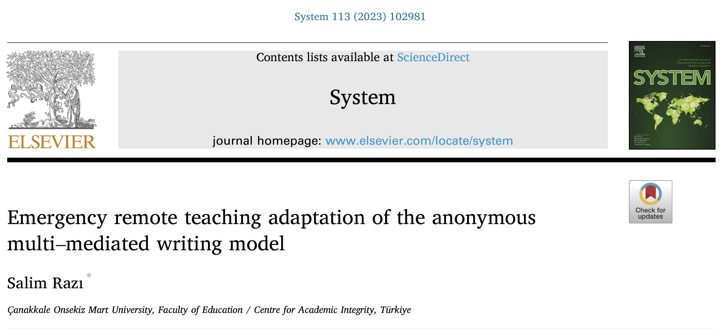
Razı, S. (2023). Emergency remote teaching adaptation of the anonymous multi-mediated writing model. System, 113, 102981. https://doi.org/10.1016/j.system.2023.102981

Slide 7
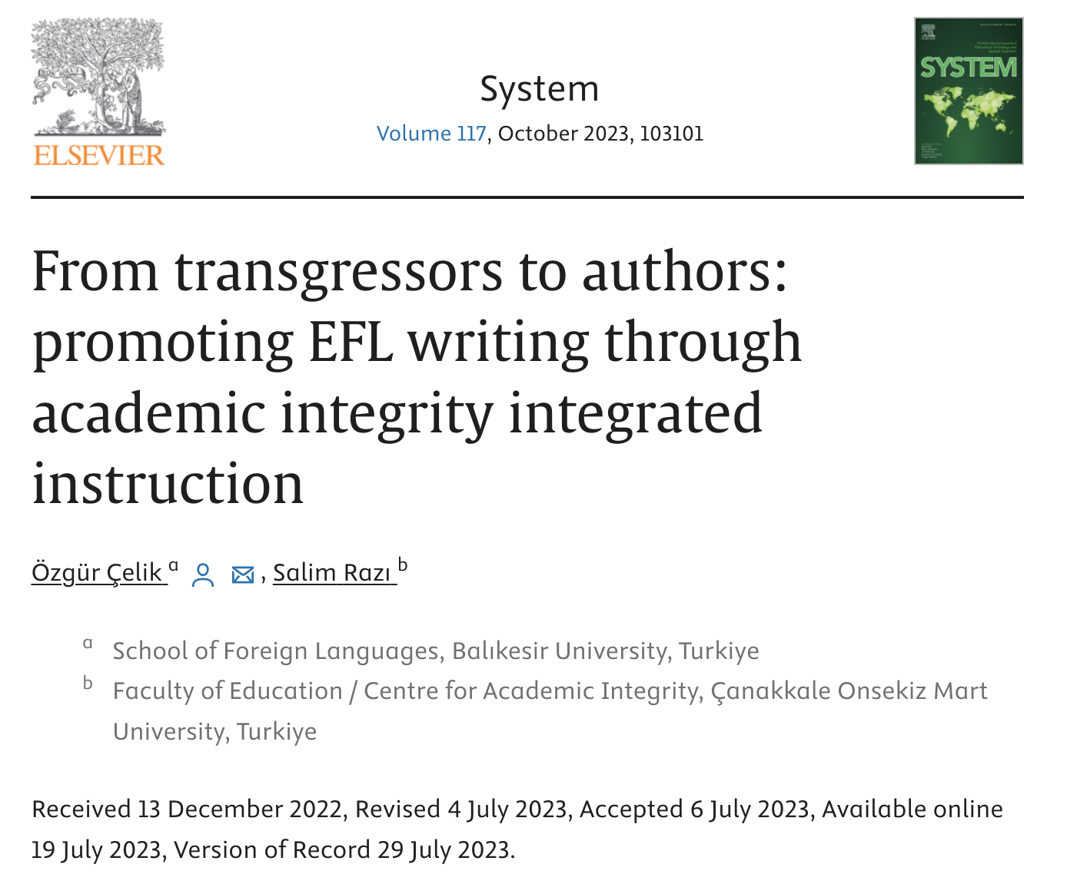
Çelik, Ö., & Razı, S. (2023). From transgressors to authors: Promoting EFL writing through academic integrity integrated instruction. System. https://doi.org/10.1016/j.system.2023.103101

Slide 8
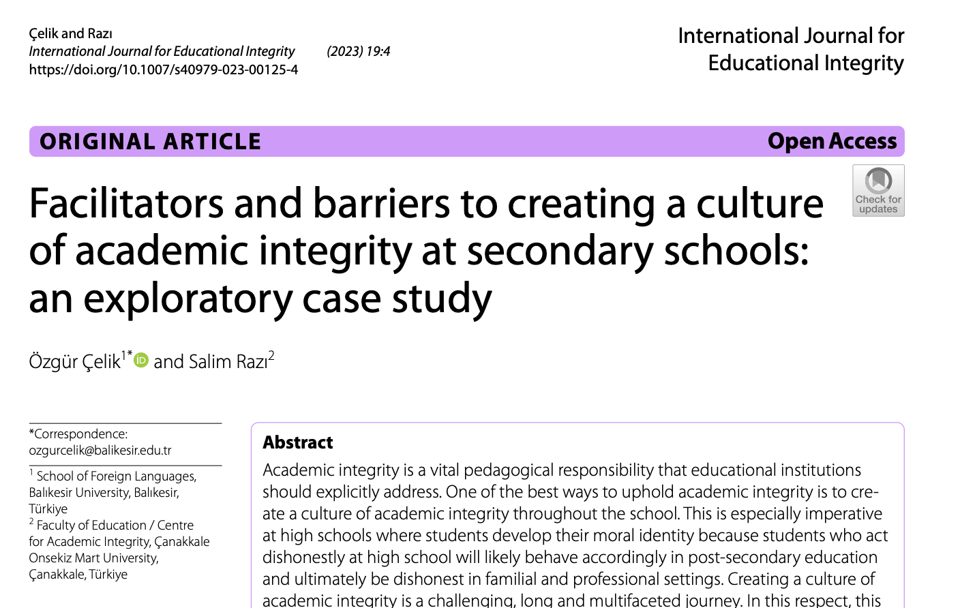
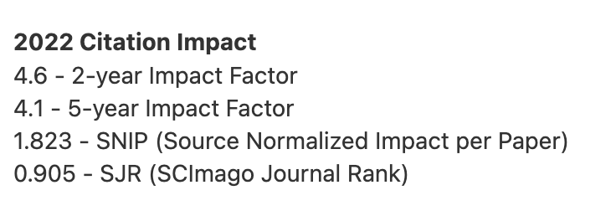
Çelik, Ö., & Razı, S. (2023). Facilitators and barriers to creating a culture of academic integrity at secondary schools: An exploratory case study. International Journal for Educational Integrity, 19(4), 1-30. https://doi.org/10.1007/s40979-023-00125-4

Slide 9
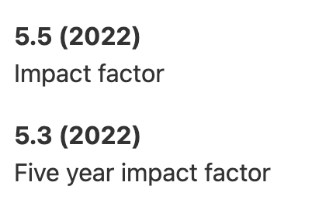
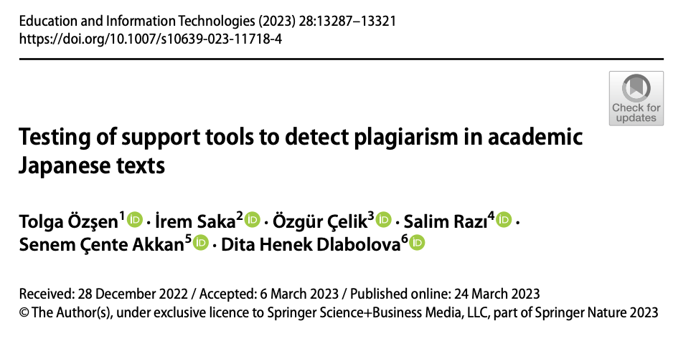
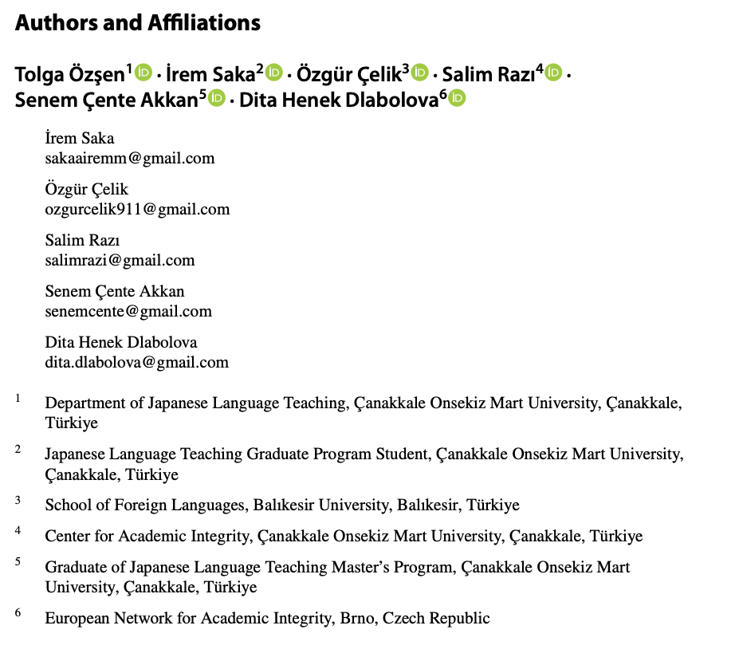
Özşen, T., Saka, İ., Çelik, Ö., Razı, S., Çente Akkan, S., Henek Dlabolová, D. (2023). Testing of support tools to detect plagiarism in academic Japanese texts. Education and Information Technologies. https://doi.org/10.1007/s10639-023-11718-4

Slide 10
Sunumlar

Slide 11
Razı, S. (2023). Facing academic integrity threats (FAITH ) project results. Conference on academic and research integrity (ACARI 2023), 17-19 December, Dubai, United Arab Emirates. https://mdx.ac.ae/acari2023
Razı, S. (2023). Instituting a culture of integrity at academia. Seminar presented at the Research ethics and integrity course. King Fahad Medical City, Saudi Arabia, 29 November.
Razı, S. (2023). Responding to artificial intelligence-generated texts in scholarly publishing. Webinar presented at the Mastering the arts of scientific writing course. King Fahad Medical City, Saudi Arabia, 24 October.
Razı, S., & Razı, B. Ö. (2023). Ethical implementation of AI in the process of academic writing. Webinar presented at the International Day of Action for Academic Integrity, International Center for Academic Integrity, 18 October. https://academicintegrity.org/events-conferences/idoa-international-day-of-action-for-academic-integrity https://youtu.be/XlwQUFPtwag?si=SIEXyIHDO4xH2LJL
Razı, S., & Özşen, T. (2023). FAITH project academic integrity corpus. Seminar delivered at the 3rd ENAI Academic Integrity PhD Summer School, 21-25 August, University of Maribor, Slovenia. http://enai-summerschool2023.um.si/
Razı, S., & Yavuz, A. (2023). Developing academic writing skills. Seminar delivered at the 3rd ENAI Academic Integrity PhD Summer School, 21-25 August, University of Maribor, Slovenia. http://enai-summerschool2023.um.si/
Özşen, T., Saka, İ., Çelik, Ö., Razı, S., Çente Akkan, S., Henek Dlabolová, D. (2023).
A methodology proposal for detecting academic misconduct in Japanese language texts in the digitalization era (Paper presentation). 17th International Conference of the European Association of Japanese Studies, 17-20 August, Genth, Brussels. https://eajs.eu/eajs-2023-conference/
Razı, S., Eaton, S. E., Reza Khan, Z., Santos, R., Çelik, Ö., Fishman, T., Sivasubramanian, S., Bjelobaba, S., Laszlo, G., & Abu-Shaheen, A. (2023). Practical responses to artificial intelligence generated texts in academic integrity policies [Paper presentation]. 9th European Conference on Ethics and Integrity in Academia (ECEIA), 12-14 July, Derby, UK. https://academicintegrity.eu/conference/wp-content/uploads/2023/07/Book-of-Abstracts-Finalised-Version-for-PDF.pdf
Razı, S., Zehir Topkaya, E., Çelik, Ö., Santos, R., & Sivasubramaniam, S. (2023). Building a higher education academic integrity policy corpus [Paper presentation]. 9th European Conference on Ethics and Integrity in Academia (ECEIA), 12-14 July, Derby, UK. https://academicintegrity.eu/conference/wp-content/uploads/2023/07/Book-of-Abstracts-Finalised-Version-for-PDF.pdf
Santos, R., Yılmaz, T. S., Çelik, Ö., Börekçi, R., Baysal Çalışkan, M., Sezgin, H., Zehir Topkaya, E., & Razı, S. (2023). A scoping review of the topics, issues and needs in current academic integrity literature [Paper presentation]. 9th European Conference on Ethics and Integrity in Academia (ECEIA), 12-14 July, Derby, UK. https://academicintegrity.eu/conference/wp-content/uploads/2023/07/Book-of-Abstracts-Finalised-Version-for-PDF.pdf
Glendinning, I, Sivasubramaniam, S., Hamza, M. A., Razı, S., Miri, S., Bjelobaba, S., & Verissimo, A. C. (2023). Developing resources for supporting ethical publishing and dissemination activities [Workshop session]. 9th European Conference on Ethics and Integrity in Academia (ECEIA), 12-14 July, Derby, UK. https://academicintegrity.eu/conference/wp-content/uploads/2023/07/Book-of-Abstracts-Finalised-Version-for-PDF.pdf
Hysaj, A., Freeman, M., Razı, S., & Reza Khan, Z. (2023). Exploring the effects of paraphrasing tools on students’ academic writing skills and any subsequent correlation with instances of plagiarism [Paper presentation]. 9th European Conference on Ethics and Integrity in Academia (ECEIA), 12-14 July, Derby, UK. https://academicintegrity.eu/conference/wp-content/uploads/2023/07/Book-of-Abstracts-Finalised-Version-for-PDF.pdf
Reza Khan, Z., Eaton, S. E., Sivasubramaniam, S., Draper, M., Santos, R., Hysaj, A., Razı, S., Gibbons, B., Stephens, M., Bjelobaba, S., & Mulani, V. (2023). A workshop on mapping academic integrity as key competence for United Nations Sustainable Development Goals [Workshop session]. 9th European Conference on Ethics and Integrity in Academia (ECEIA), 12-14 July, Derby, UK. https://academicintegrity.eu/conference/wp-content/uploads/2023/07/Book-of-Abstracts-Finalised-Version-for-PDF.pdf

Slide 12
Reza Khan, Z., Reddy, M., Ike, T. C., Dyer, J., Razı, S., Bjelobaba, S., Sivasubramaniam, S., Rogerson, A., & Waddington, L. (2023). Sharing experiences: Development of a game-based module to raise awareness on avoiding plagiarism [Paper presentation]. 9th European Conference on Ethics and Integrity in Academia (ECEIA), 12-14 July, Derby, UK. https://academicintegrity.eu/conference/wp-content/uploads/2023/07/Book-of-Abstracts-Finalised-Version-for-PDF.pdf
Sivasubramaniam, S., Razı, S., & Reza Khan, Z. (2023). “Be clear about being unclear”: Ambiguous assessment briefs resulting in misinterpretations and academic misconducts [Paper presentation]. 9th European Conference on Ethics and Integrity in Academia (ECEIA), 12-14 July, Derby, UK. https://academicintegrity.eu/conference/wp-content/uploads/2023/07/Book-of-Abstracts-Finalised-Version-for-PDF.pdf
Çelik, Ö., Barnhardt, B., Fleming, C., Henek Dlabolová, D., Saygı, G., Kennedy, I. G., Glendinning, I., Morrow, L., Santos, R., Razı, S., Sivasubramaniam, S., Yılmaz, T. S., Hossain, Z., & Reza Khan, Z. (2023). Academic integrity in school education: Exploring the research landscape [Paper presentation]. 9th European Conference on Ethics and Integrity in Academia (ECEIA), 12-14 July, Derby, UK. https://academicintegrity.eu/conference/wp-content/uploads/2023/07/Book-of-Abstracts-Finalised-Version-for-PDF.pdf
Glendinning, & Razı, S. (2023). Ethical publishing and dissemination workshop [Workshop session]. Pre-conference workshops of the 9th European Conference on Ethics and Integrity in Academia (ECEIA), 11 July, Derby, UK. https://academicintegrity.eu/conference/
Razı, S. (2023). Promoting a culture of academic integrity. Webinar delivered at the Academic Integrity Awareness Week, 27 May, Leeds Trinity University Birmingham Campus, UK.
Razı, S. (2023). Facing academic integrity threats (FAITH). Seminar delivered at the Academic Integrity Roadshow Pre-Conference Event: 1st Asia-Middle East-Africa Conference on Academic and Research Integrity, 4 May, Ajman University, Dubai, UAE.
Razı, S. (2023). Facing academic integrity threats (FAITH). Seminar delivered at the Academic Integrity Roadshow Pre-Conference Event: 1st Asia-Middle East-Africa Conference on Academic and Research Integrity, 3 May, Zayed University, Dubai, UAE.
Razı, S. (2023). Ethics and integrity in teacher education. Panel discussion at the Academic Integrity Roadshow Pre-Conference Event: 1st Asia-Middle East-Africa Conference on Academic and Research Integrity, 2 May, University of Wollongong in Dubai, UAE.
Razı, S. (2023). Policies to address ethical considerations associated with the use of AI technologies. Webinar on Chat GPT, AI, and Academic Integrity: Challenges and Opportunities, Pre-Conference Event: 1st Asia-Middle East-Africa Conference on Academic and Research Integrity, 27 April, Centre for Academic Integrity Pakistan & Punjab Higher Education Commission, Pakistan.
Razı, S. (2023). Anonymous multi-mediated writing model in preventing plagiarism. Webinar at PUPP (Partnership on University Plagiarism Prevention) Project Webinar Series, 26 April. https://youtu.be/ojyxcKdXM44 https://pupp.uqo.ca/en/event/anonymous-multi-mediated-writing-model-in-preventing-plagiarism/
Gniel, H., Lyons, C., Razı, S., & Boland, M. (2023). Academic integrity: Safeguarding trust in higher education. Panel session at the International Network for Quality Assurance Agencies in Higher Education (INQAAHE) Talks, 29 March. https://www.inqaahe.org/blog/seventh-inqaahe-talks-webinar
Ene, E., Razı, S., McGrath, L., Vance, J., & Douglas, S. (2023). SLW materials for adult education, ESP, academic integrity, and play. SLW-MW Interest Section panel at TESOL 2023 International Convention & English Language Expo, 21-24 March, Portland, Oregon. https://www.tesol.org/tesol-convention-2023
Razı, S. (2023). Facing academic integrity threats (FAITH). Presentation at CEENQA Bimonthly Meeting, 18 January. https://www.ceenqa.org/wp-content/uploads/FAITH_CEENQA_18.01.2023.pdf

Slide 13
Kitap Bölümleri

Slide 14
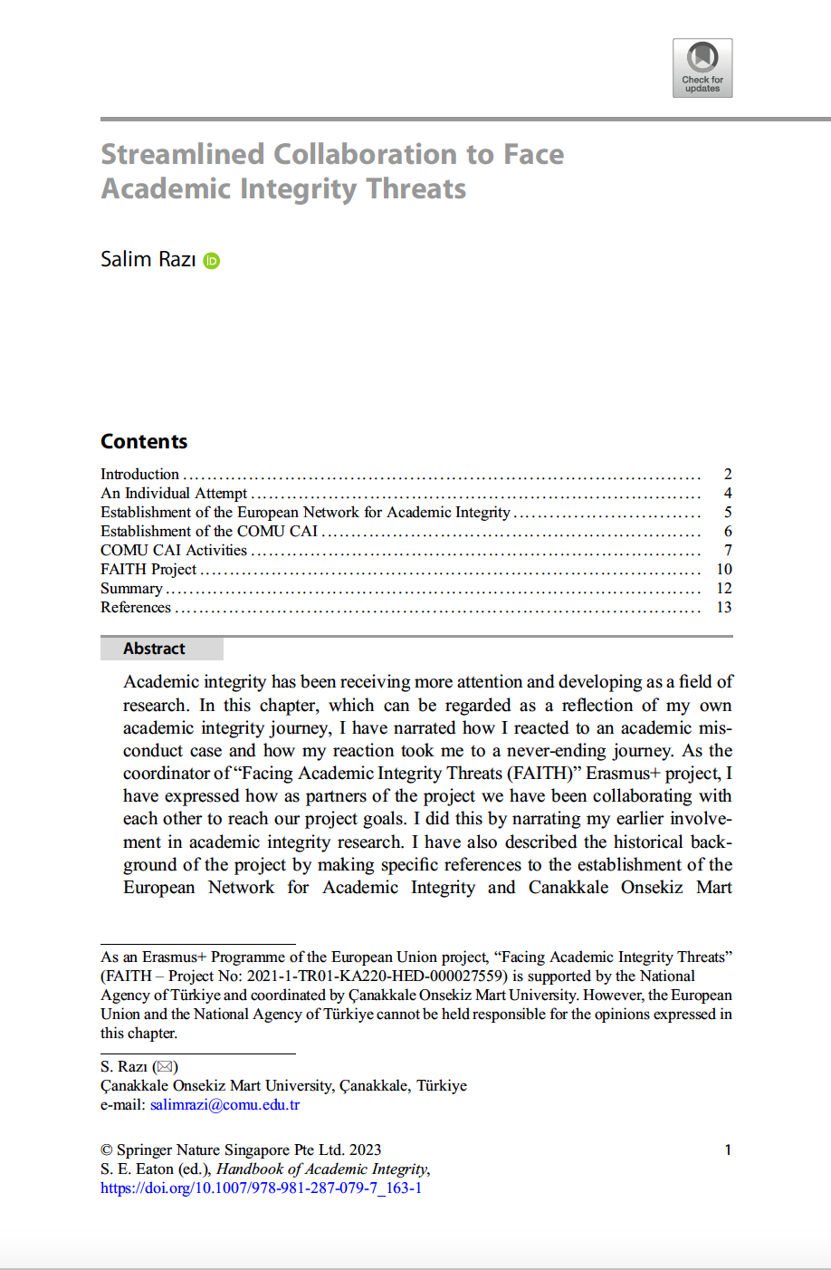
Razı, S. (2023). Streamlined collaboration to face academic integrity threats. In S. E. Eaton (Ed.), Handbook of academic integrity (2nd ed.). Springer. https://doi.org/10.1007/978-981-287-079-7_163-1

Slide 15
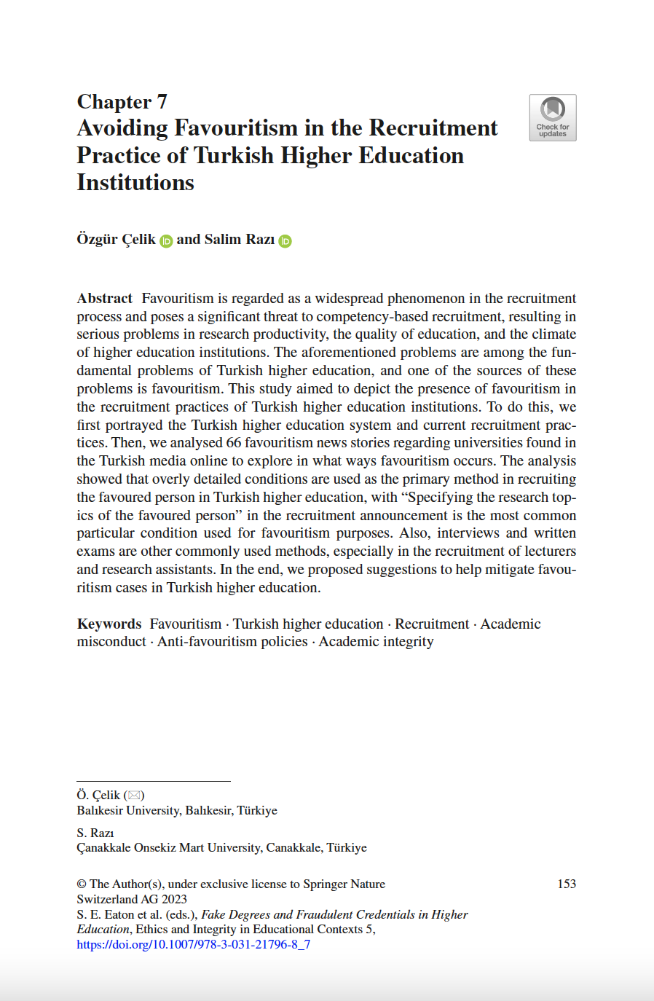
Çelik, Ö., & Razı, S. (2023). Avoiding favoritism in Turkish higher education recruitment practices. In S. E. Eaton, J. J. Carmichael, & H. Pethrick (Eds.), Fake degrees and fraudulent credentials in higher education (pp. 153-167). Springer. https://link.springer.com/chapter/10.1007/978-3-031-21796-8_7

Slide 16
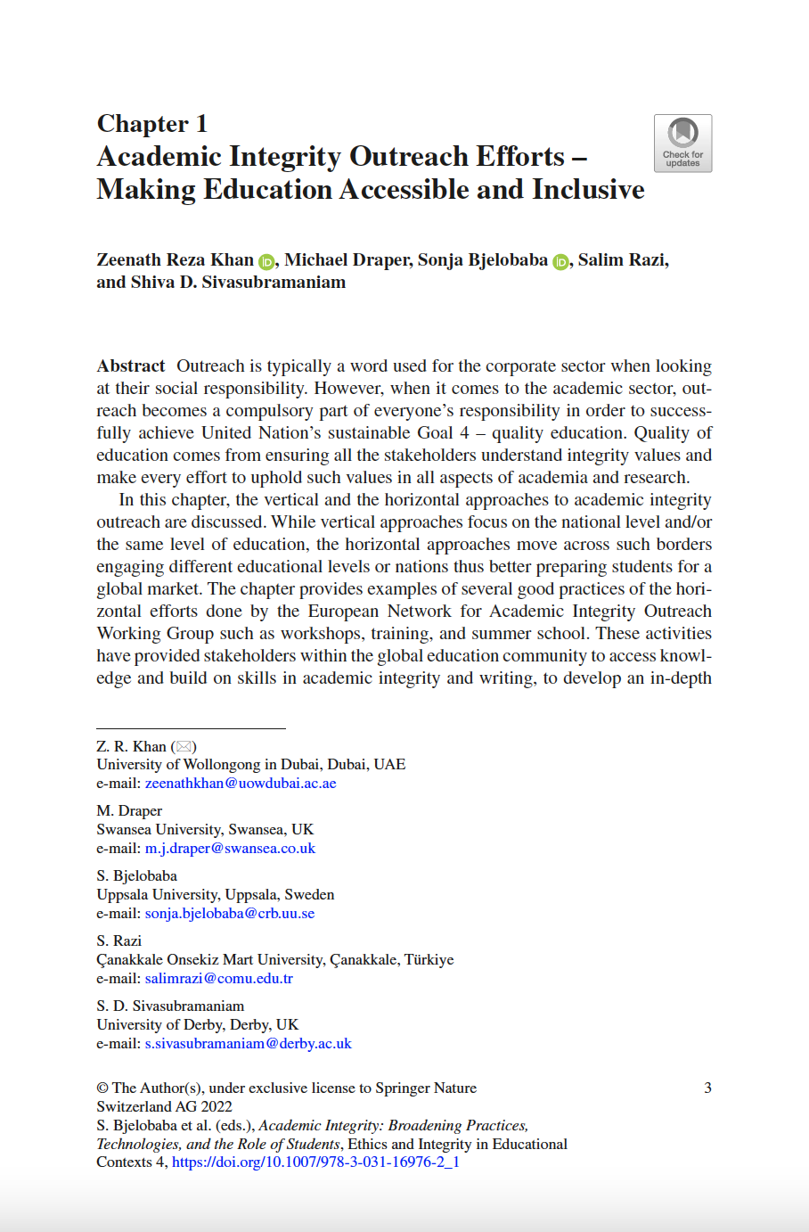
Khan, Z. R., Draper, M., Bjelobaba, S., & Razı, S., & Sivasubramaniam, S. (2023). Academic integrity outreach efforts – making education accessible and inclusive. In S. Bjelobaba, T. Foltýnek, I. Glendinning, V. Králíková, & D. Henek Dlabolová (Eds.), Academic integrity: Broadening practices, technologies, and the role of students (pp. 3-16). Springer. https://link.springer.com/chapter/10.1007/978-3-031-16976-2_1

Slide 17
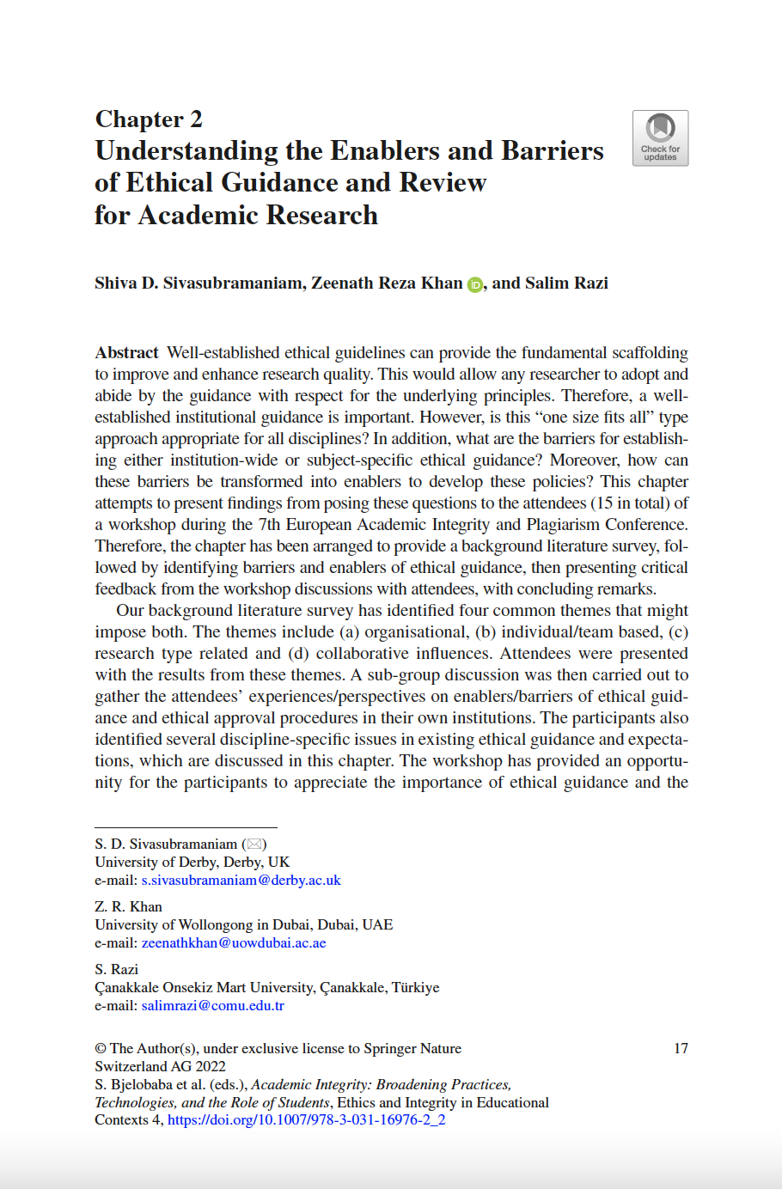
Sivasubramaniam, S., Khan, Z. R., & Razı, S. (2023). Understanding the enablers and barriers of ethical guidance and review for academic research. In S. Bjelobaba, T. Foltýnek, I. Glendinning, V. Králíková, & D. Henek Dlabolová (Eds.), Academic integrity: Broadening practices, technologies, and the role of students (pp. 17-28). Springer. https://link.springer.com/chapter/10.1007/978-3-031-16976-2_2

Slide 18
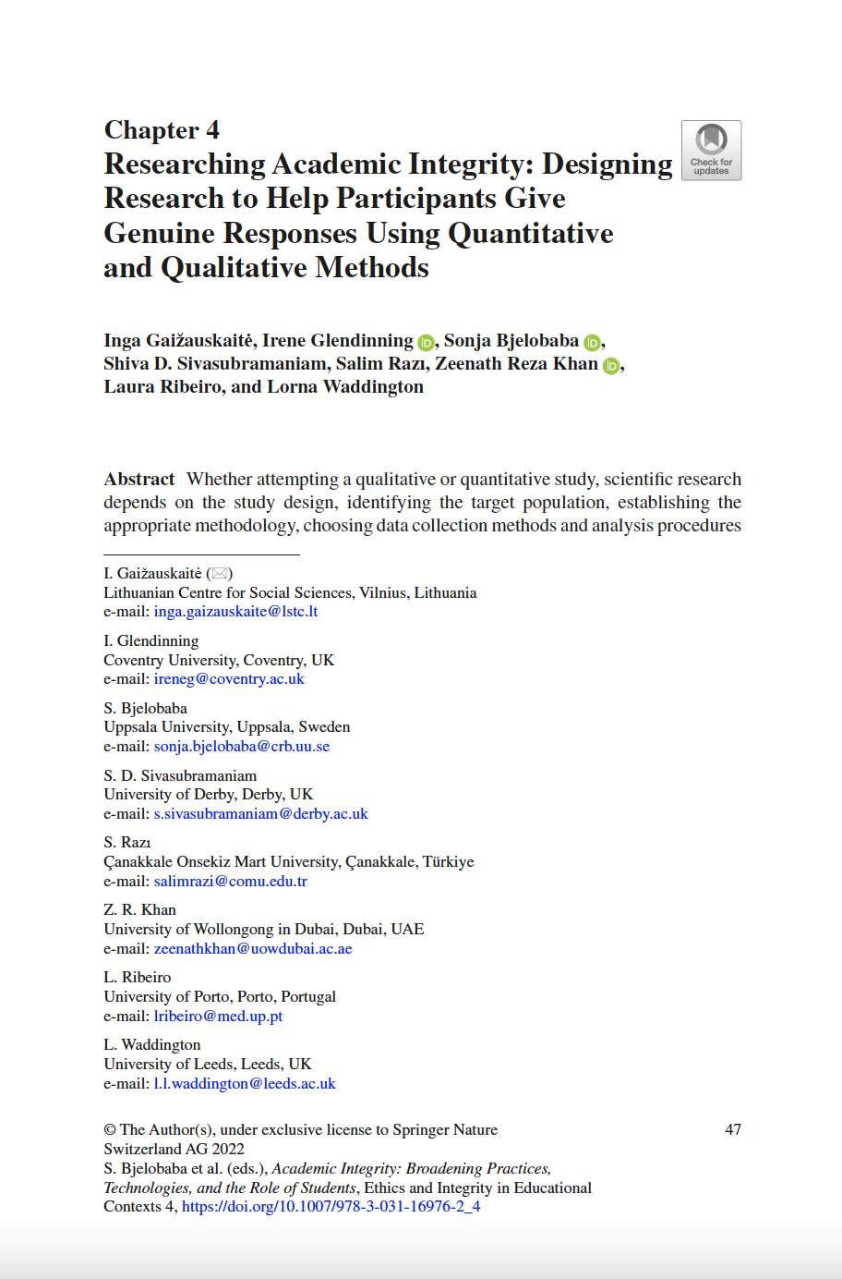
Gaižauskaitė, I., Bjelobaba, S., Sivasubramaniam, S., Razı, S., Khan, Z. R., Ribeiro, L., & Waddington, L. (2023). Researching academic integrity: Designing research to help participants give genuine responses using quantitative and qualitative methods. In S. Bjelobaba, T. Foltýnek, I. Glendinning, V. Králíková, & D. Henek Dlabolová (Eds.), Academic integrity: Broadening practices, technologies, and the role of students (pp. 47-65). Springer. https://link.springer.com/chapter/10.1007/978-3-031-16976-2_4

Slide 19
Network Oluşturma

Slide 20
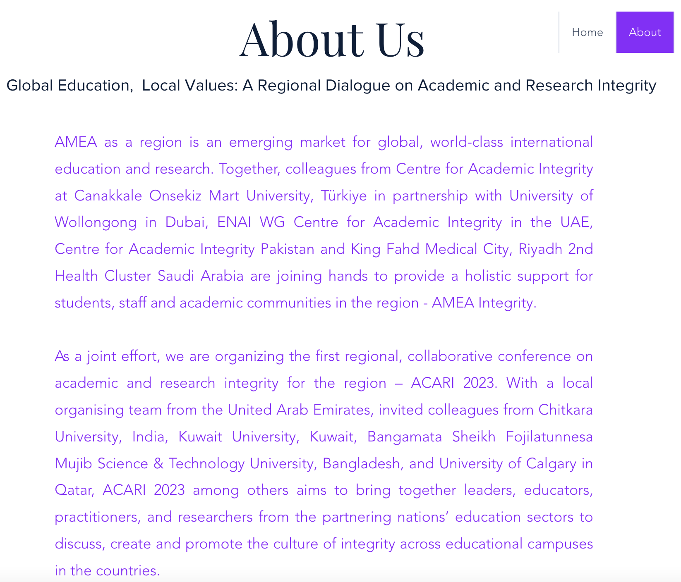
Merkezimiz Asya, Orta Doğu ve Afrika bölgelerine yönelik akademik dürüstlük ağının kurulmasına öncülük etmiştir. https://www.amea-integrity.com/about-1

Slide 21
Etkinlik Düzenleme

Slide 22
Yütücüsü olduğumuz “Facing Academic Integrity Threats (FAITH)” projesi kapsamında Maribor Üniversitesi Slovenya’da “Akademik Dürüstlük Doktora Yaz Okulu" programı düzenlenmiştir. http://enai-summerschool2023.um.si/

Slide 23
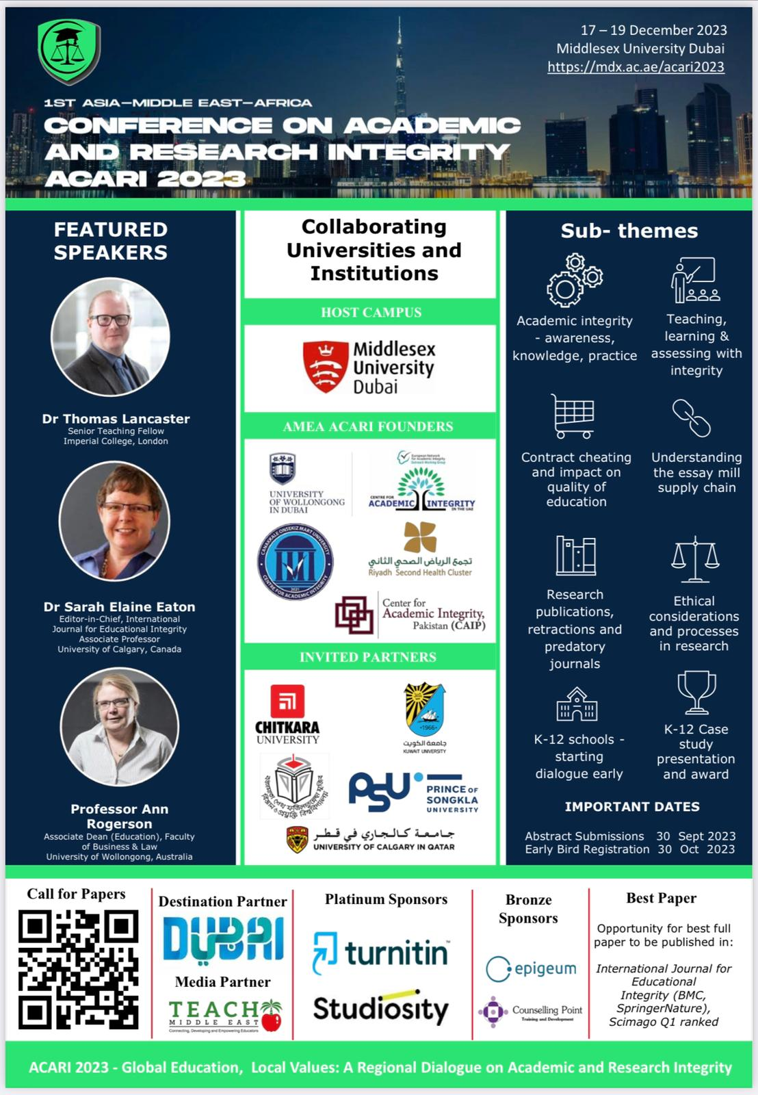
Asya, Orta Doğu ve Afrika bölgelerine yönelik akademik dürüstlük ağı olarak ilk konferansımızı gerçekleştirmiş bulunuyoruz.
https://mdx.ac.ae/acari2023

Slide 24
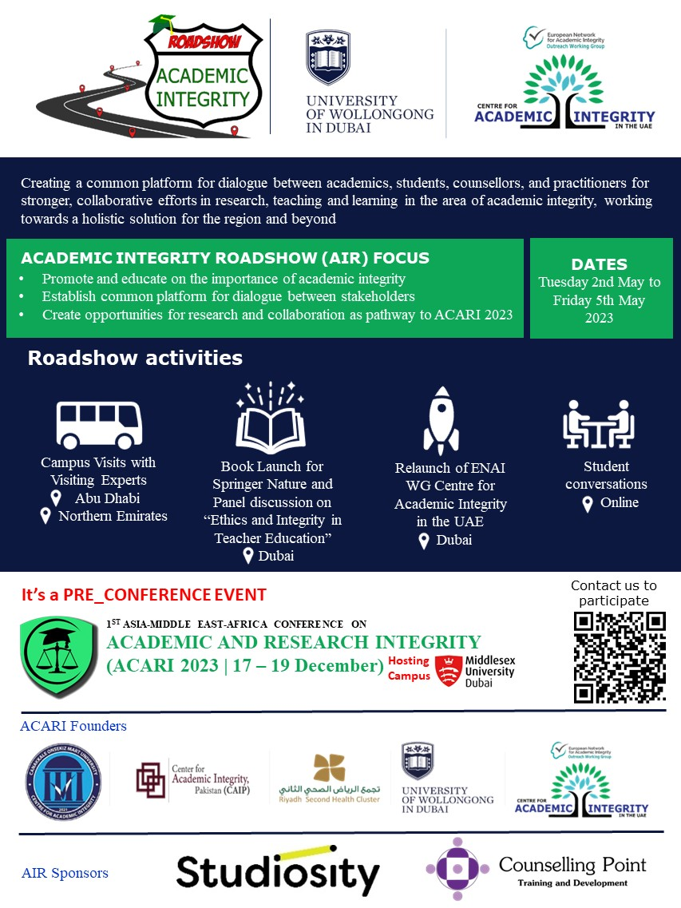
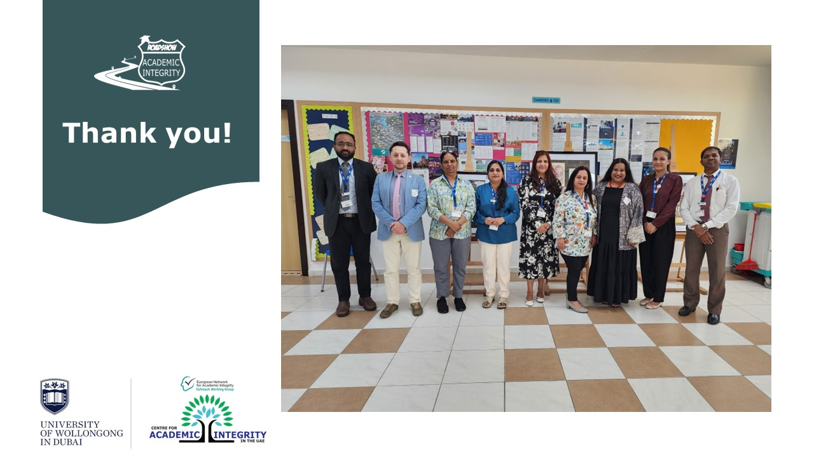
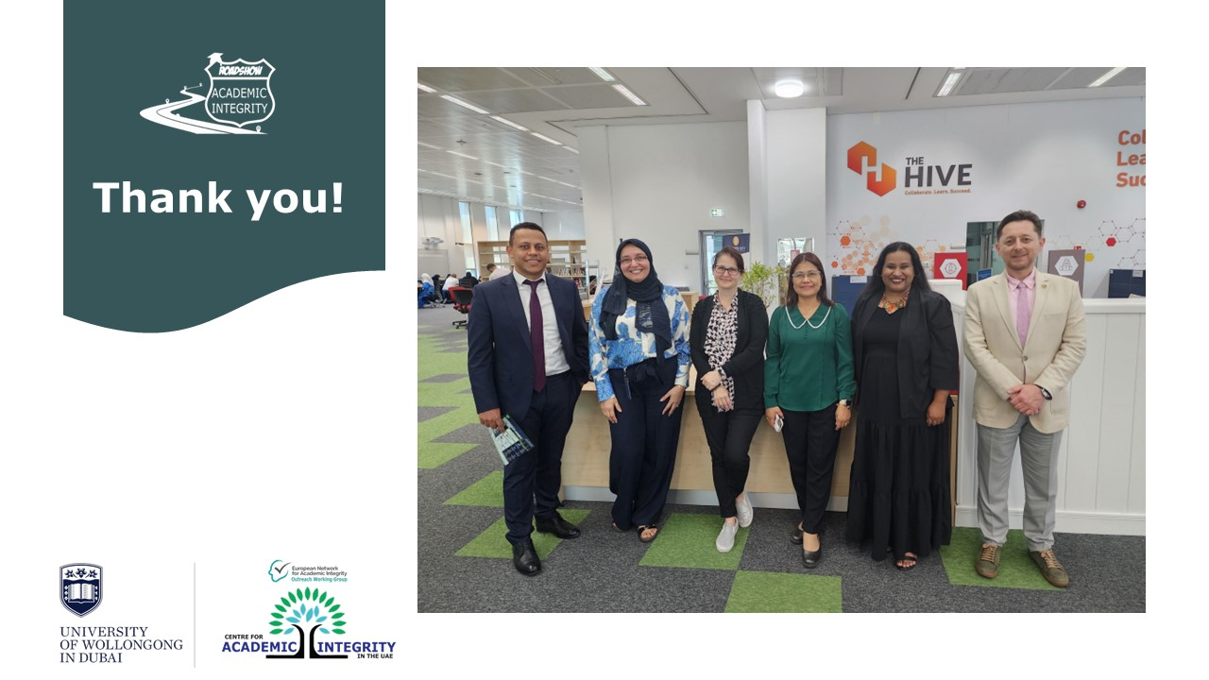
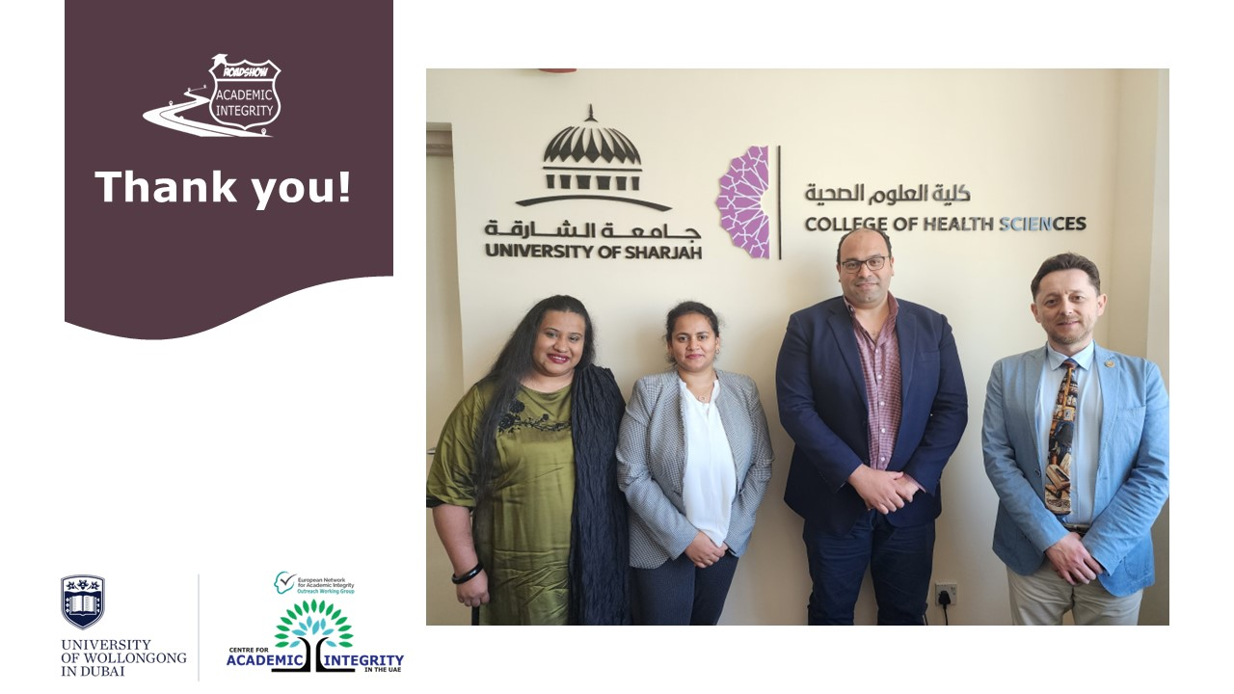
Söz konusu konferansın tanıtım etkinliğini Birleşik Arap Emirlikleri’nde beş farklı emirlikteki üniversiteleri yerinde ziyaret ederek gerçekleştirmiş bulunuyoruz.

