Slide 1
Çanakkale Onsekiz Mart University, Turkey-Russia Cooperation, Research and Application Center (TURUSIA)
турецко-российского сотрудничества в области исследований и практики (TУРУСИА), Университета Чанаккале Онсекиз Март
«100th Anniversary of Compulsory Stay of White Russians in Gallipoli»
100-летие Галиполийского сидения белогвардейцев

Slide 2
About TURUSIA
Turkey-Russia Cooperation, Research and Application Center (TURUSIA) has started to its activities with the establishment announcement published in 30565 issue of the Official Journal on 14 October 2018. TURUSIA aims to seek cooperation issues and opportunities between Turkey and Russia in academic, cultural, education and several economic sectors.
Objectives
The objectives of the center are
• Investigate existing and potential cooperation issues between Turkey and Russia;
• Undertake research on scientific, cultural, technological and sectoral areas in order to develop bilateral cooperation between Turkey and Russia;
• Enable supporting, improving and publishing such research;
• Conduct cooperation and coordination mission between national and international institutions aiming to develop cooperation between Turkey and Russia.
TURUSIA also admit to contribute connection between Turkey and Russia through Gallipoli due to its intersecting significance and meaning both in Turkey and Russia histories.

Slide 3
TURUSIA Mission
Promoting Gallipoli’s historical importance and its peace message in international platforms with regard to cultural dialogue between Turkey and Russia.
Conducting theoretical and applied research on various topics related to enhancing bilateral cooperation between Russia and Turkey; to support and publish such research,
Supporting mutual visits will contribute to developing cooperation between Turkey and the Russian Federation,
Providing academic support to institutions and organizations aiming at mutual or joint investments on commercial and economic issues through projects.

Slide 4
TURUSIA Perspective
•Organizing promotional events for instances of human solidarity between Turkey and Russia societies that took place in Gallipoli in the past,
•Creating opportunities for both communities to get to know each other through events that highlighting examples of cooperation and solidarity in the historical process,
•Preparing projects for the lasting cooperation for the development of academic, cultural and economic relations between Russia and Turkey,
•Supporting students and researchers through collaboration agreements and protocols for bilateral education and research activities,
•Extending the cooperation fields by taking advantage of practical tools such as vocational courses, vocational personnel exchange and training programs, courses and internships etc.,
•Organizing events such as congress, symposium, conferences, panels, workshops and etc. with other local, national and international institutions working on Turkey and Russia relationships,
•Conducting market research in accordance with requests from private or public institutions or organizations; preparing projects, reports on these issues; creating research and application units related to the requested projects,

Slide 5
100th Anniversary of Compulsory Stay of White Russians in Gallipoli
Turkey and Russia are two important countries of Eurasia which is always important to each other. The good neighborhood relations in this challenging and large part of political geography are of profound importance due to the continually changing world conditions.
In order to build on this process solid foundations, cultural dialogue channels should be increased as well as the fields of cooperation should be diversified and developed.

Slide 6
The years we have been going through constitute a period when the centenaries which are of importance for the Turkish-Russian relations have been taking place one after another. As known, the year 2019 was declared “the Turkey-Russia Cross Year of Culture and Tourism”. The year 2020 is the centenary of the Formation of Diplomatic Relations between Turkey and Russia. Furthermore, the year 2021 will be the centenary of the Moscow Agreement. The years 2020-2023 will be the centenary of the Stay of White Russians Abroad in Gallipoli. As known, White Russians had arrived in Gallipoli after the Bolshevik Revolution in November 1920 and the last group left Gallipoli in May 1923.

Slide 7
In the Turkish-Russian relations, the anniversaries of such historic events provide favorable possibilities to develop multidimensional relations.
The brotherhood relations, the foundations of which were laid in Gallipoli, maintain their mission of forming a strong bridge of culture and friendship between the two countries.
With the study presented here, it is intended to draw attention to “Gallipoli” – an important fact in the histories of both countries. Various proposals are made with respect to experiencing the centenaries more fruitfully and efficiently.

Slide 8
The importance of the Gallipoli Fact
As it is known, after the Bolshevik Revolution, hundreds of thousands of White Russians became a refuge in various countries of the world. At that time, Turkey had hosted about 200.000 people by opening its borders. While civilians reaching Turkey had been placed in İstanbul, about 30.000 soldiers, officers, and their families had to face a forced exile in Gallipoli in 1920-1923.
The life of the White Russians in Gallipoli is one of important phenomenon in the history of the 20th century. This experience has a great impact and social importance for the Russian and Turkish peoples. First of all, this is a proud part of the history of the two countries.

Slide 9
The Russian monument built in Gallipoli in 1921, but disbanded over time, was rebuilt in 2008. The Gallipoli Russian Monument represents the memory of 30,000 White Russians and 342 White Russians buried in Gallipoli.
The monument was opened with a well-attended ceremony on 17 May 2008.This process soon led to important developments in the Turkish-Russian relations. The reconstruction of the monument in Gallipoli provided the establishment of a cultural bridge between the two countries. Upon the opening of the monument and of the unit functioning as a small museum immediately next to it, the visits to Gallipoli from Russia increased with every passing day.
Today this monument is the symbol of good neighbourly relations, friendship and peace between Turkey and Russia which are two important countries of Eurasia.

Slide 10
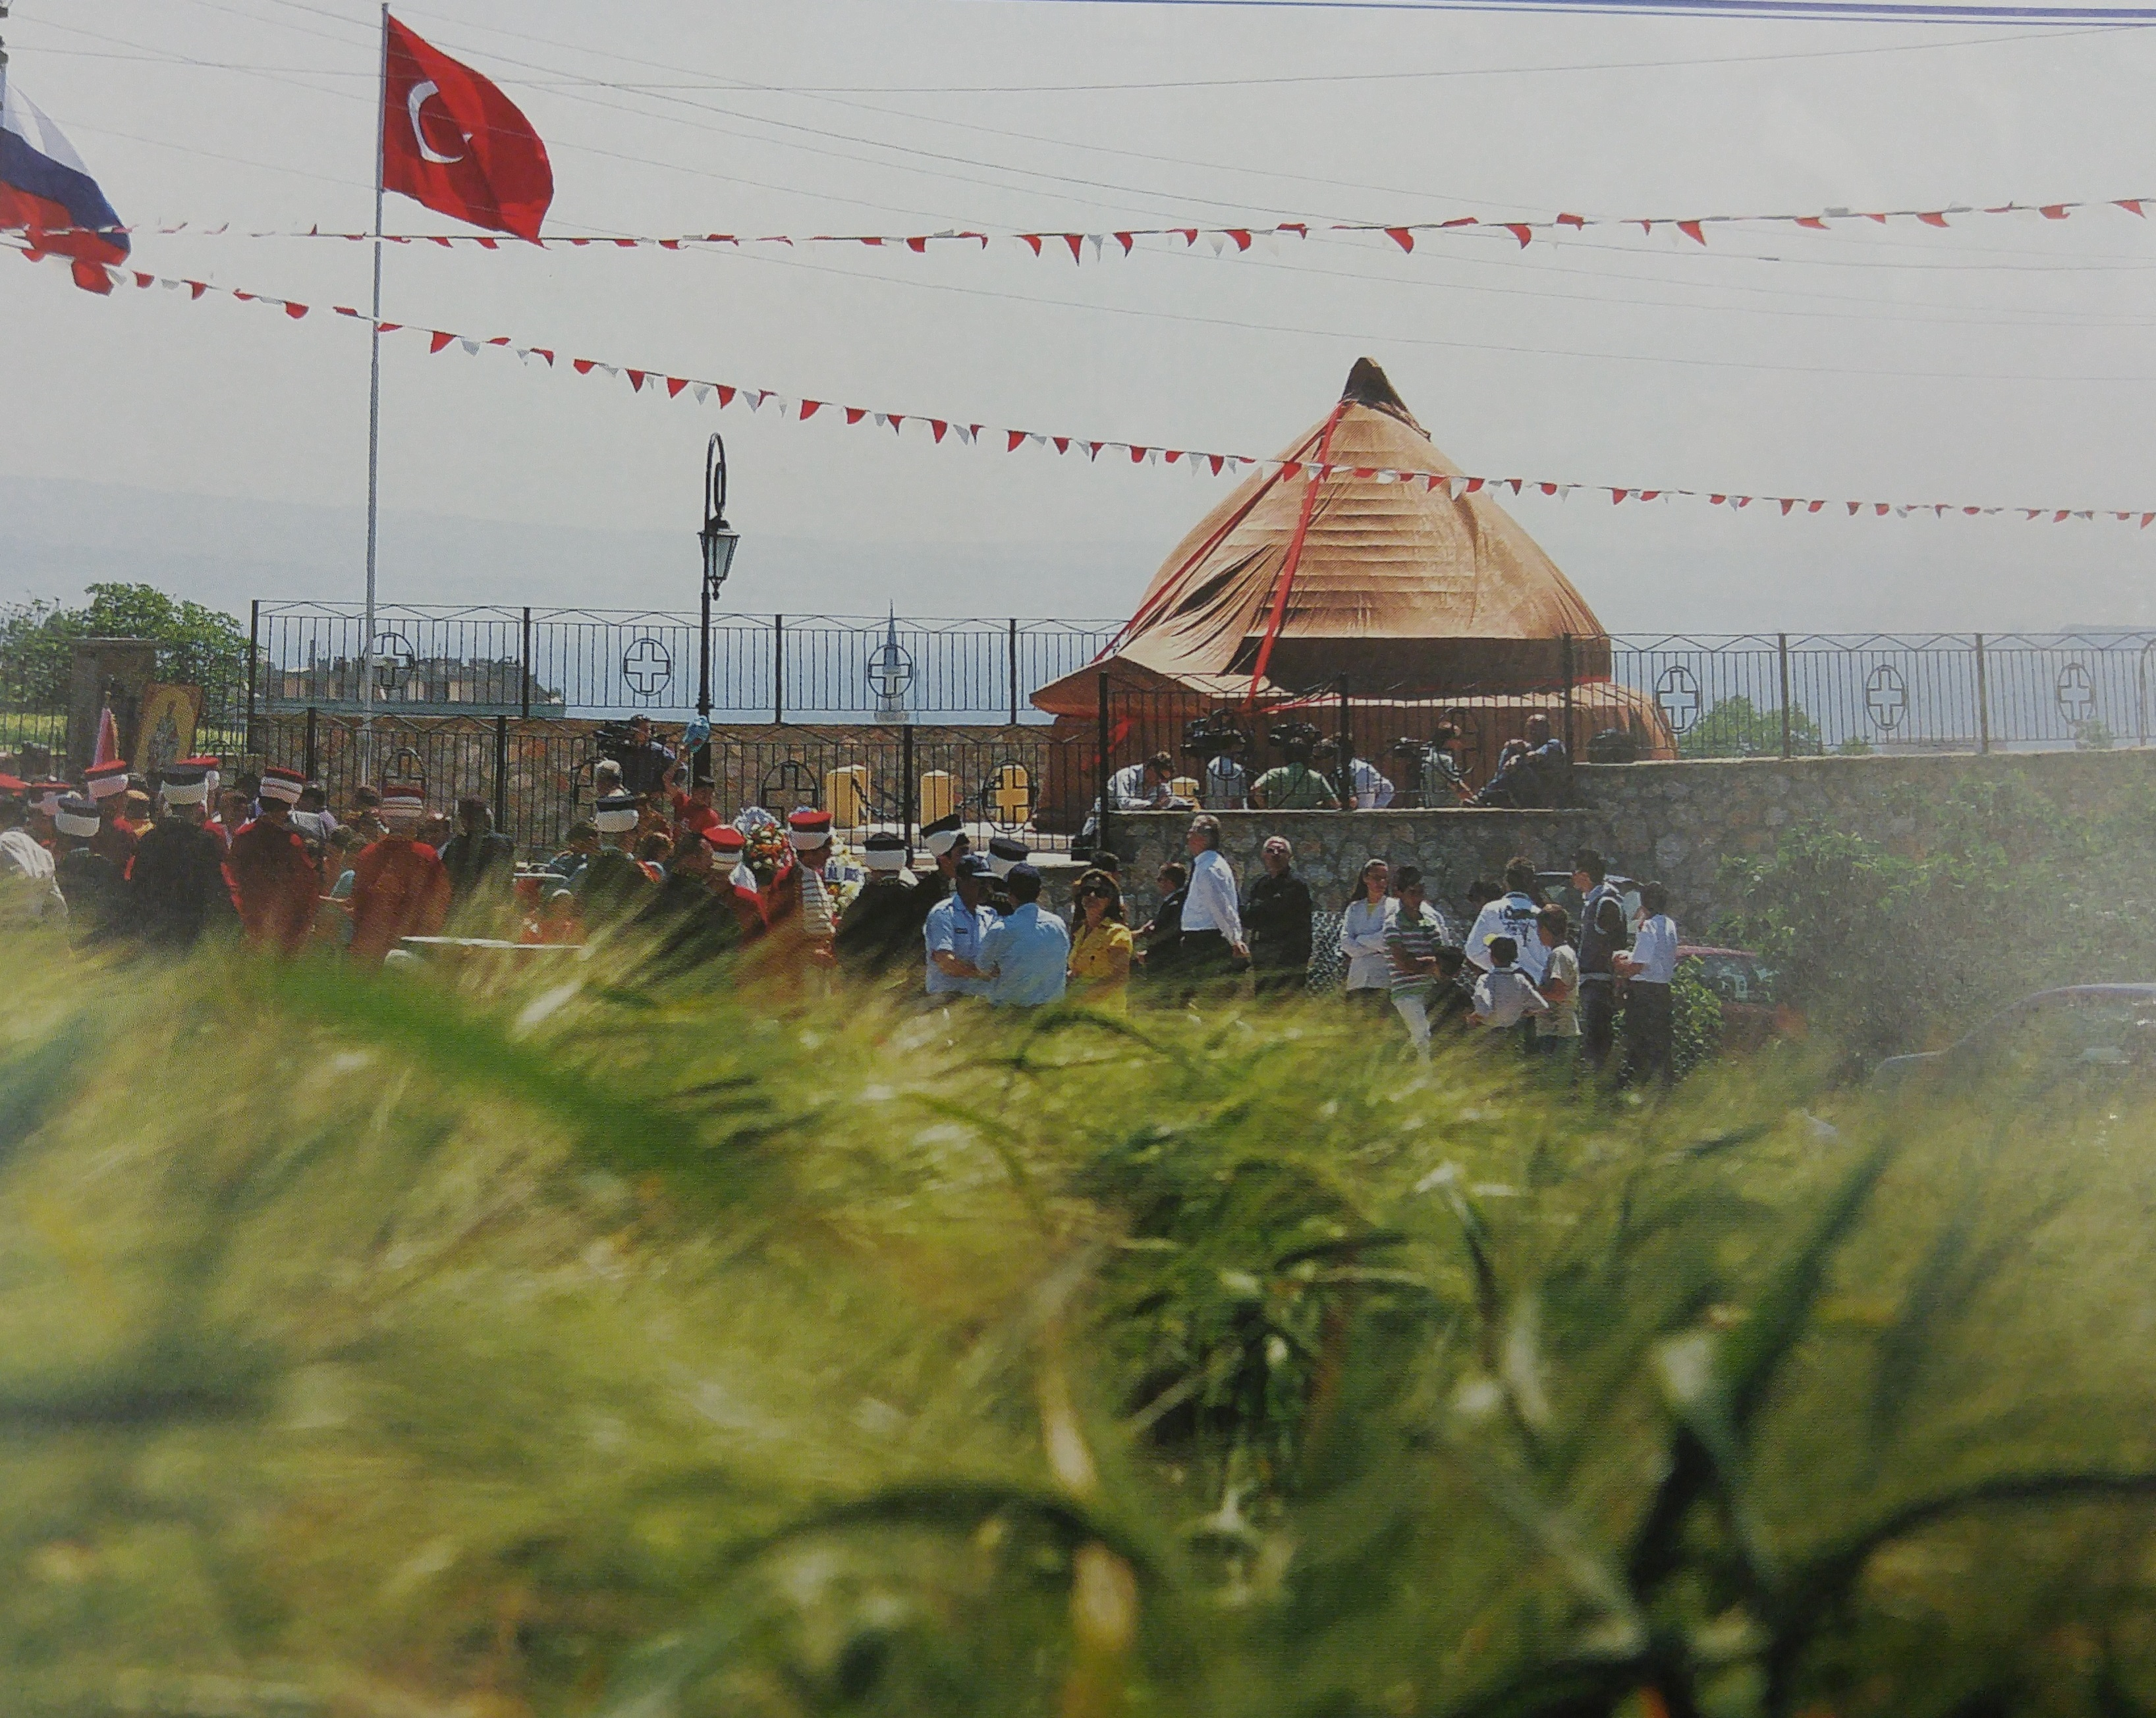

Slide 11
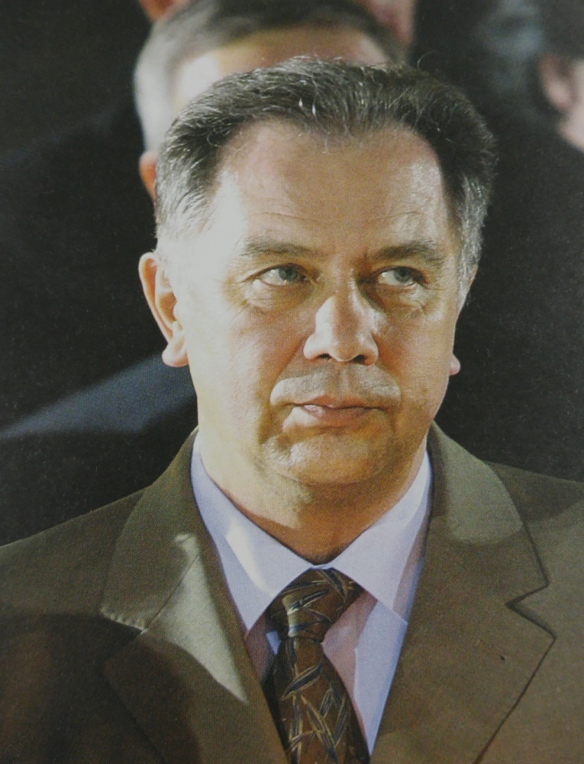
Minister of culture of Russia and Oscar-winning director Nikita Mihalkov were also at the opening ceremony. Mr. Sokolov said at the time:
There are several very important positive events in Russian history. The first is the battle of Kulikova, the second is the battle of Borodino and the third is the Kurskaya Duga. The fourth and most important event is the Gallipoli life of the Russians. Alexander SOKOLOV, Russian Minister of Culture and Mass Communications, May, 17 2008, Gallipoli

Slide 12
In the last one-year section of the process extending to the 100th Anniversary of the Gallipoli Memorial, many works were accomplished in Çanakkale.
What have we done in the last two years?

Slide 13
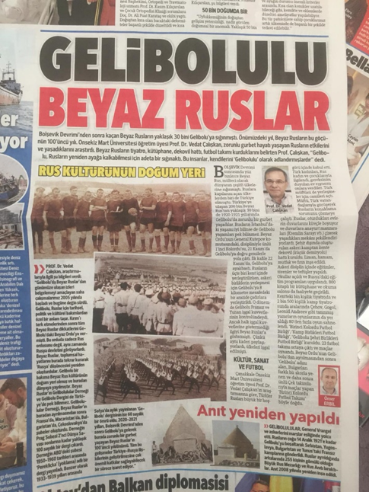
On March 31, 2019, Our researches about the Russians of Gallipoli have been published in the Hürriyet newspaper as headlines and interviews. which is the one of the important newspapers of the national press.

Slide 14
On April 6, 2019, CNNTURK TV channel announced our activities with titles such as "Turkish-Russian Friendship in Gallipoli ”and “100-Year Friendship ” that provides positive impact on public.

Slide 16
On April 12, 2019, We made a celebration and working visit to Mr Cavit ÇAĞLAR who was a former State Minister of Turkey and awarded with "Friendship Medal" by Viladimir PUTIN, President of Russia

Slide 17
May 13, 2019, a public conference entitled "Russia from Manchuria to the Baltics" has been held at Çanakkale Onsekiz Mart University. Russia's attractiveness for tourism was introduced by Mustafa Andıç who is so well-known tour operator in Turkey.

Slide 18
A public panel entitled "Towards to 100th Anniversary of Compulsory stay of White Russians in Gallipoli" was organized. Opening speeches were made by Mustafa ÖZACAR, Gallipoli Mayor; Prof. Enver SHEYKOV from Rrossotrudnichestvo Turkey Office; Melis MURAT, on behalf of the St. Andrew Foundation; Ahmet Berat ÇONKAR, Turkish Russian Civic Forum Co-Chairmanmand İsmail SAFİ, Turkish Presidential Security Council Member.

Slide 19
A documentary film was shown publicly (Open Door Anatolia: Russians)

Slide 20
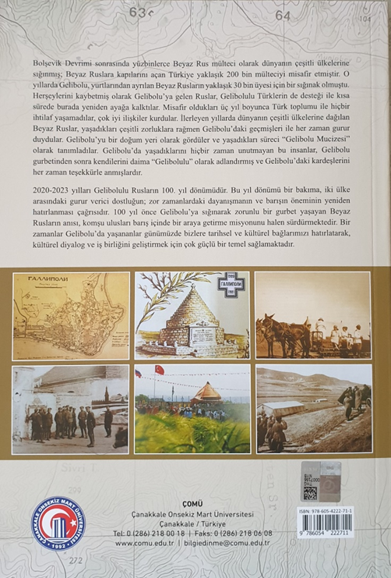
100-летие Галиполийского сидения белогвардейцев The book entitled "100th Anniversary of Compulsory Stay of White Russians in Gallipoli (1920-1923/2020-2023)" was published by the support of TURUSIA

Slide 21
Our book "100th Anniversary of the Russians from Gallipoli", published in 2019 as the publication of Çanakkale Onsekiz Mart University, was translated into Russian and published in Russia.

Slide 23
The Russian Embassy in Ankara has issued a message thanking the management of our research center TURUSIA for the tree planting in Gallipoli to commemorate its 100th anniversary.

Slide 24
Ankara Turkish-Russian Friendship House Culture and Art Museum, which was established on the 100th anniversary of the memories of Ankara and Gallipoli of Turkish-Russian relations, was opened with a ceremony held on Friday, 01.10.2021.

Slide 25
In addition to the "Gallipoli Memorial Corner" that welcomes the visitors in the garden at the entrance of the museum, the "Gallipoli-1921" photography exhibition on the ground floor was held in cooperation with ÇOMU-TURUSIA, Gallipoli Municipality and Turkish-Russian Friendship House.

