Slide 1
Çanakkale Onsekiz Mart University
Non-Governmental Organizations Application and Research Center 2023 Activities

Slide 2
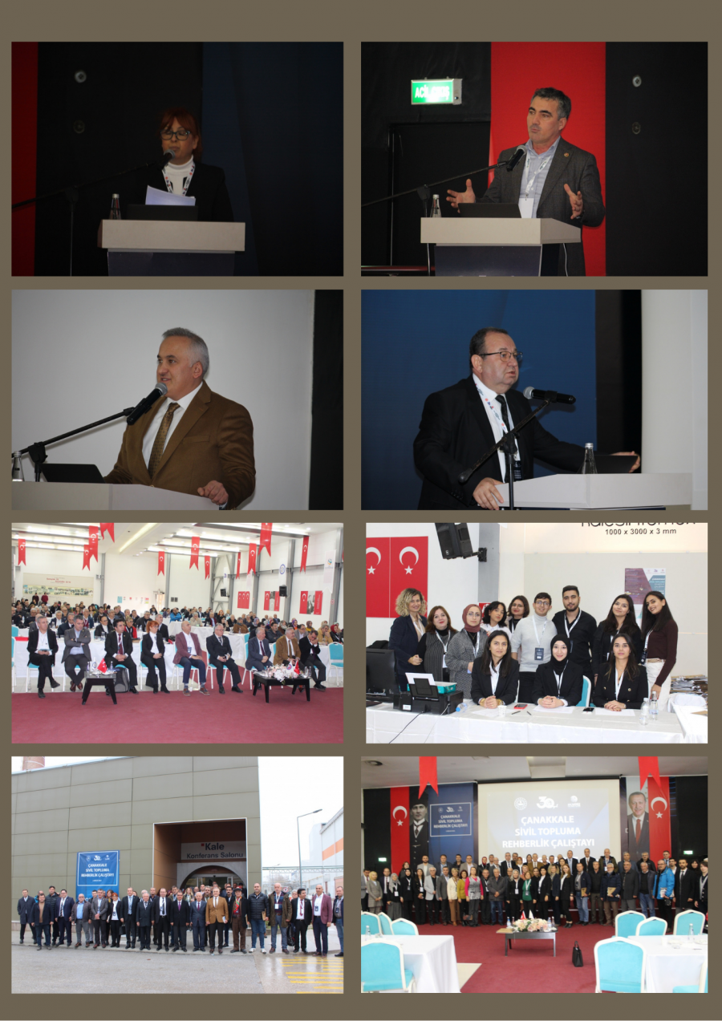
Canakkale Civilian To society
Guidance workshop
one
Importance and Problems of NGOs
2
of Çanakkale
NGO Ecosystem
3
The Role of ÇOMÜ and the Private Sector

Slide 3
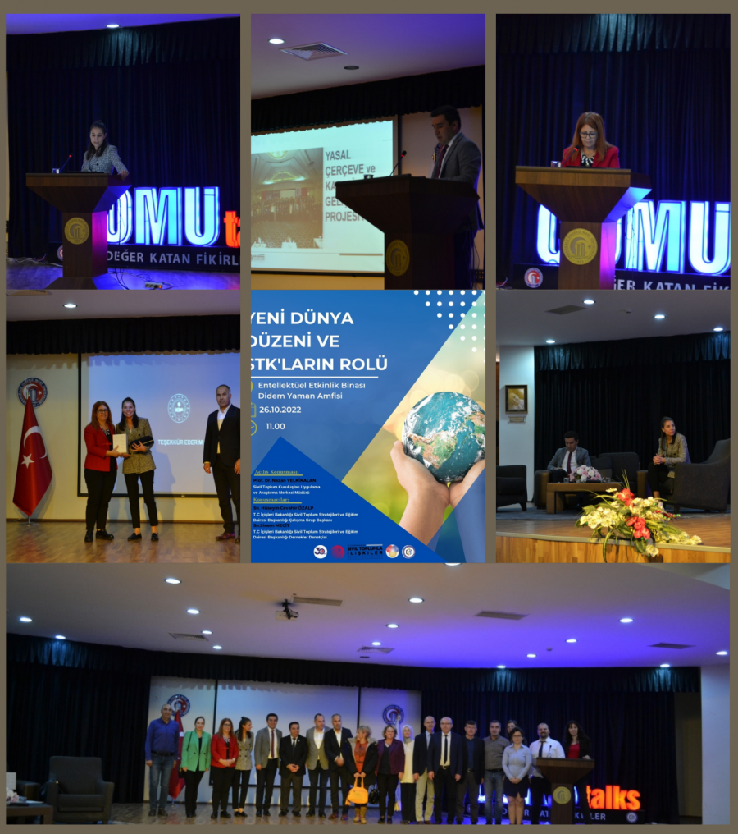
Panel: New World Order and the Role of NGOs
one
Agenda
The purpose of the event was to discuss and determine the role that non-governmental organizations will play in the global order.
2
Participants
Hüseyin Cevahir Özalp and Sinem Mecit from the Civil Society Strategies and Education Department of the Ministry of Internal Affairs attended the panel as speakers.
3
Evaluation
Director of ÇOMÜ Non-Governmental Organizations Application and Research Center Prof. Dr. Nazan Yelkikalan The opening speech made by and the potential impact of the panel on young people attracted great attention.

Slide 4
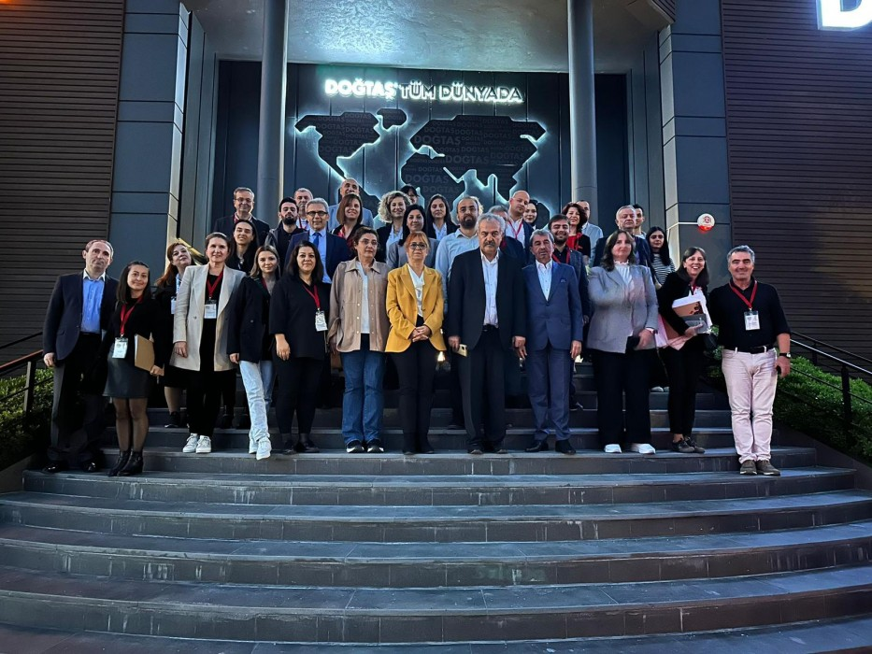
Search Conference: Common Vision in Business Education quest
Theme
An interactive panel was held with the participation of the business world, NGO representatives and academicians in order to direct business education correctly.
Panelists
Among the panelists of the panel; Davut Doğan, Sabri Sözen, Prof. Dr. Levent Şahin, Kazım Çalışkan and other experts from the sector were present.
Partnership
Detailed discussions were held on the opportunities and contributions offered to students by the cooperation between university and business representatives.

Slide 5
How Should Business Education Be?
Presidential
Participation
Support for Students
The panel was chaired by former ÇOMU Rector and current Arel University Graduate Education Institute Director Prof. Dr. Ali Akdemir performed it.
In the panel; Successful names from the business world, university representatives and industry experts attended.
Panelists highlighted efforts to provide internship and job opportunities to young students.

Slide 6
CIVIL SOCIETY ACADEMY:
ONLINE CERTIFIED
EDUCATIONAL PROGRAM
Aim
civil​ society organizations person source their capacity increase , civil society legislation , volunteering And social entrepreneurship subjects first to be about civilian to society aimed at current on matters civilian society establishment representatives of information levels to develop And professional worker person the number of to increase
Target group
civil​ society establishment representatives , university to his students And civilian society in the field to work or voluntarily to be wanting all to citizens
APPLICATION
16 October 2023 – 10 November 2023 1st Round
4 December 2023-15 December 2023 2nd Round
Online Training - Total 100 Participants
Partnership
Ministry of Interior and in cooperation with ÇOMÜ

Slide 7
SHORT TERM ACTIVITY PLAN
Central Website
Quality Assurance Studies

Slide 8
Unachievable and
2024 Planned Activities
Social Projects And Civilian Society Organizations Management Afar Education without thesis Degree Program
XI. International NGOs congress

