Slide 1
Underwater Research and Application Center
2022 Activity Presentation

Slide 2
Vision of the Underwater Research and Application Center
To closely monitor national and international underwater science and technology, to carry out underwater research, and to support the training of underwater researchers and other researchers primarily for national needs.

Slide 3
Vision of the Underwater Research and Application Center
To be a respected, institutionalized research institution on international platforms that provides support to education and the private sector in training knowledgeable, internationally recognized researchers specialized in underwater research.

Slide 4
Activities carried out by our center in 2022
Our center completed 1 project that started in 2021 in 2022, and then started a second project in a different region. In addition, it has partnered in 3 sea cleaning activities. It was among the partners who organized the National Underwater Scientific Research and Values Symposium, which was held between 20-22 October 2022.
A cooperation protocol was signed between Çanakkale Onsekiz Mart University and Balıkesir Metropolitan Municipality. Within the scope of this protocol, the Underwater Research and Application Center together with the Faculty of Marine Sciences and Technology on behalf of the University carried out the project named "Ghost Net Hunters, Marmara" and this project was terminated in July 2022.

Slide 5
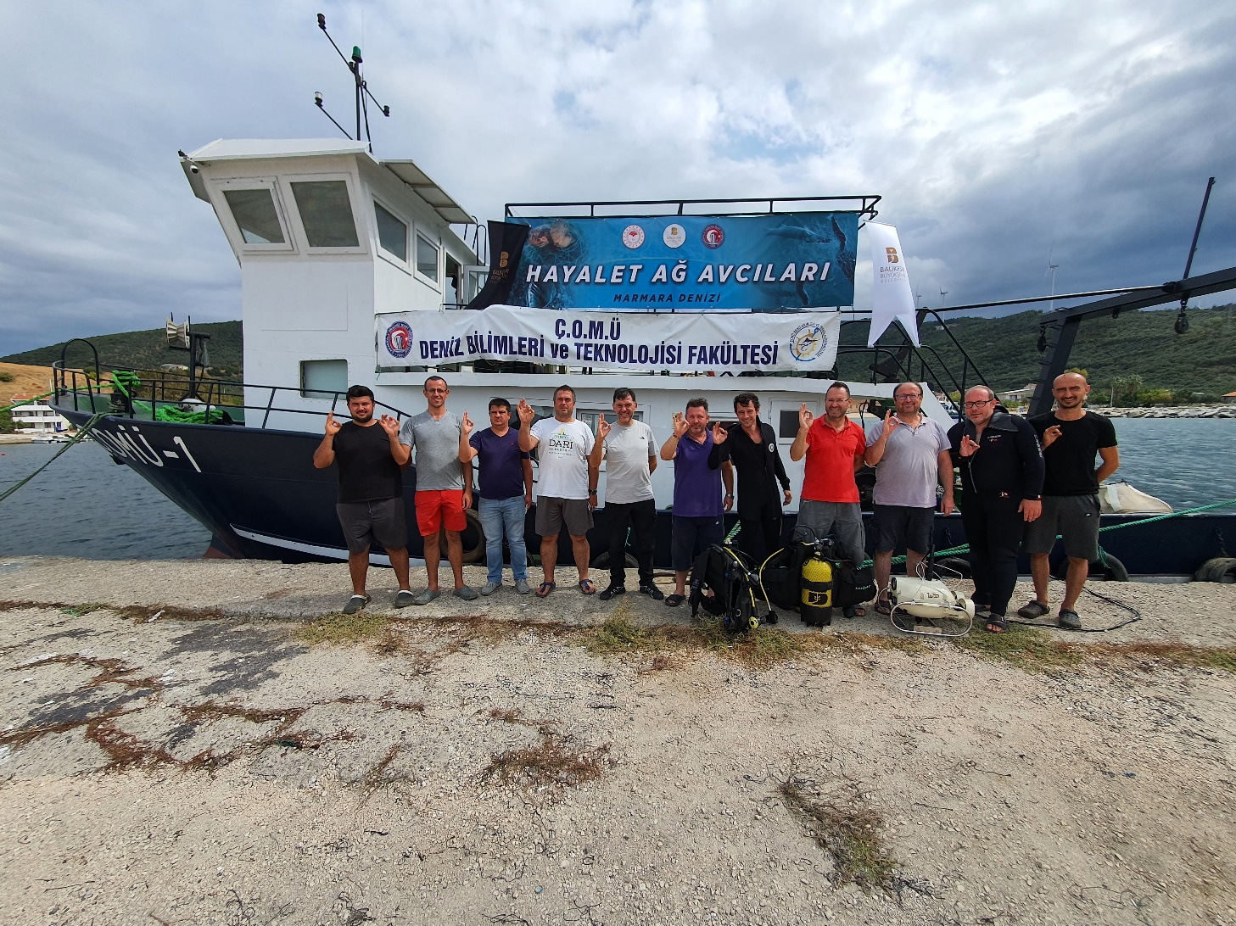
Ghost Net Hunters, Marmara
This project started in July 2021 and was completed in July 2022. Within the scope of the project, 32 dives were carried out in the Kapıdağ Peninsula and Islands Region, a total of 20 hours of bottom time was spent and an area of 14500 m2 was scanned. From the scanned areas, 1 trawl net, 1 algarna, 18500 m2 purse seine net pieces, 700 m trawl and plain gill nets, 2 longlines, 8 ship anchors, 1 octopus fishing line and piece gillnets were removed from the seabed.
In addition to the participation of our entire Central board of directors, our doctor and graduate students also participated in the project. In this way, the diving training of our students has been reinforced.

Slide 6
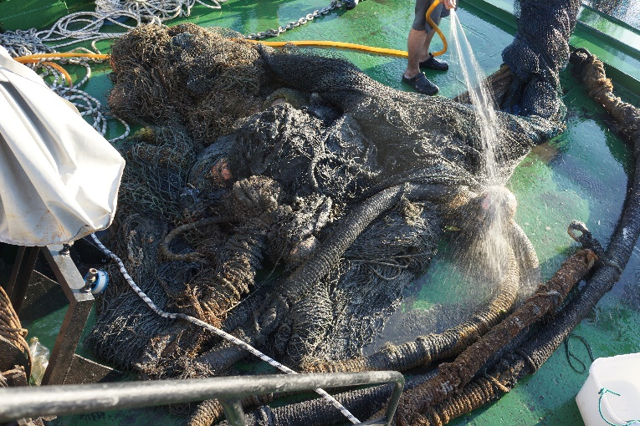
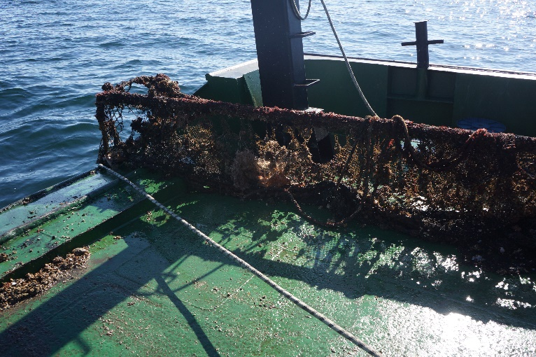
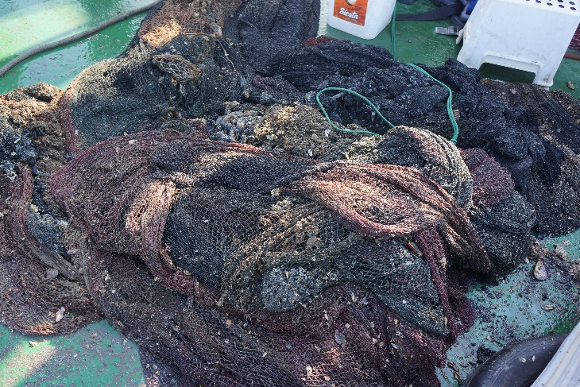
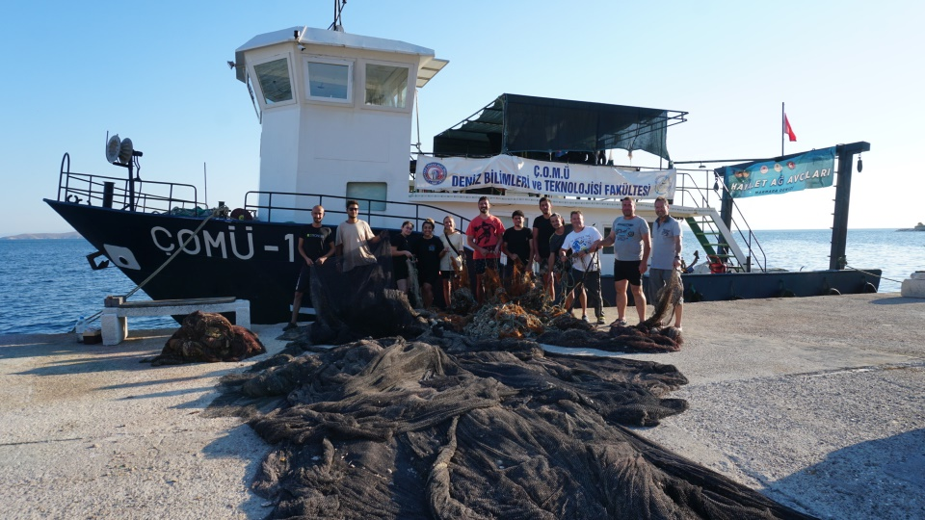
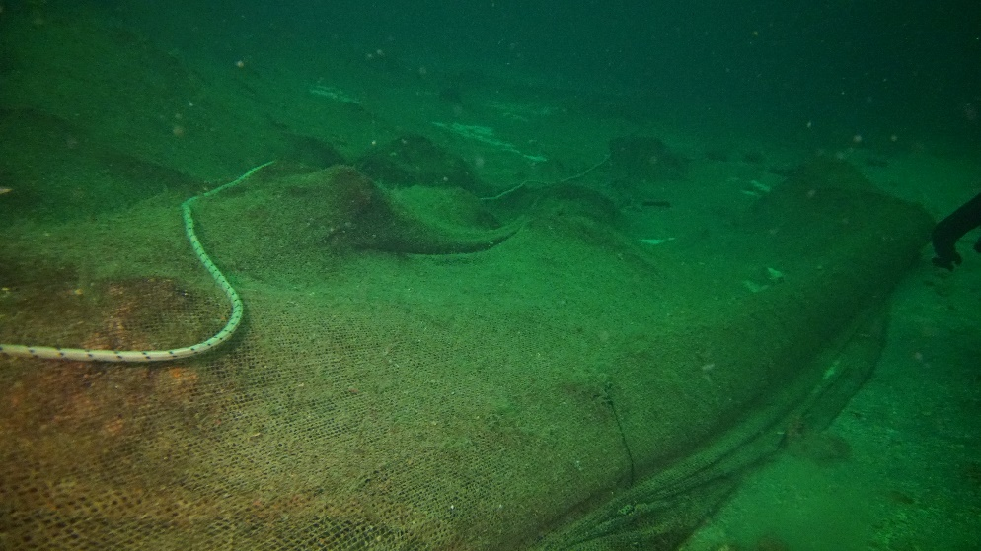
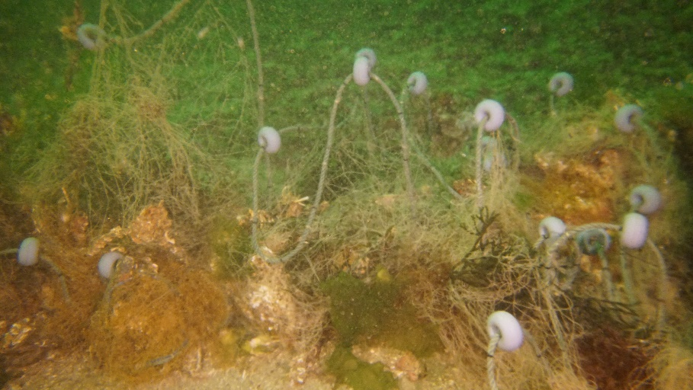
Ghost Net Hunters, Marmara Project
Pieces of purse seine net lifted from the sea in Bandırma Bay
Trawl net recovered from the sea
Beam trawl recovered from the sea
Pieces of purse seine and other nets lifted from the sea on Marmara Island
A piece of a seine net lifted from the sea off the shores of Hayırsız Island
Lost tammel nets lifted from the sea off the coast of Marmara Island

Slide 7
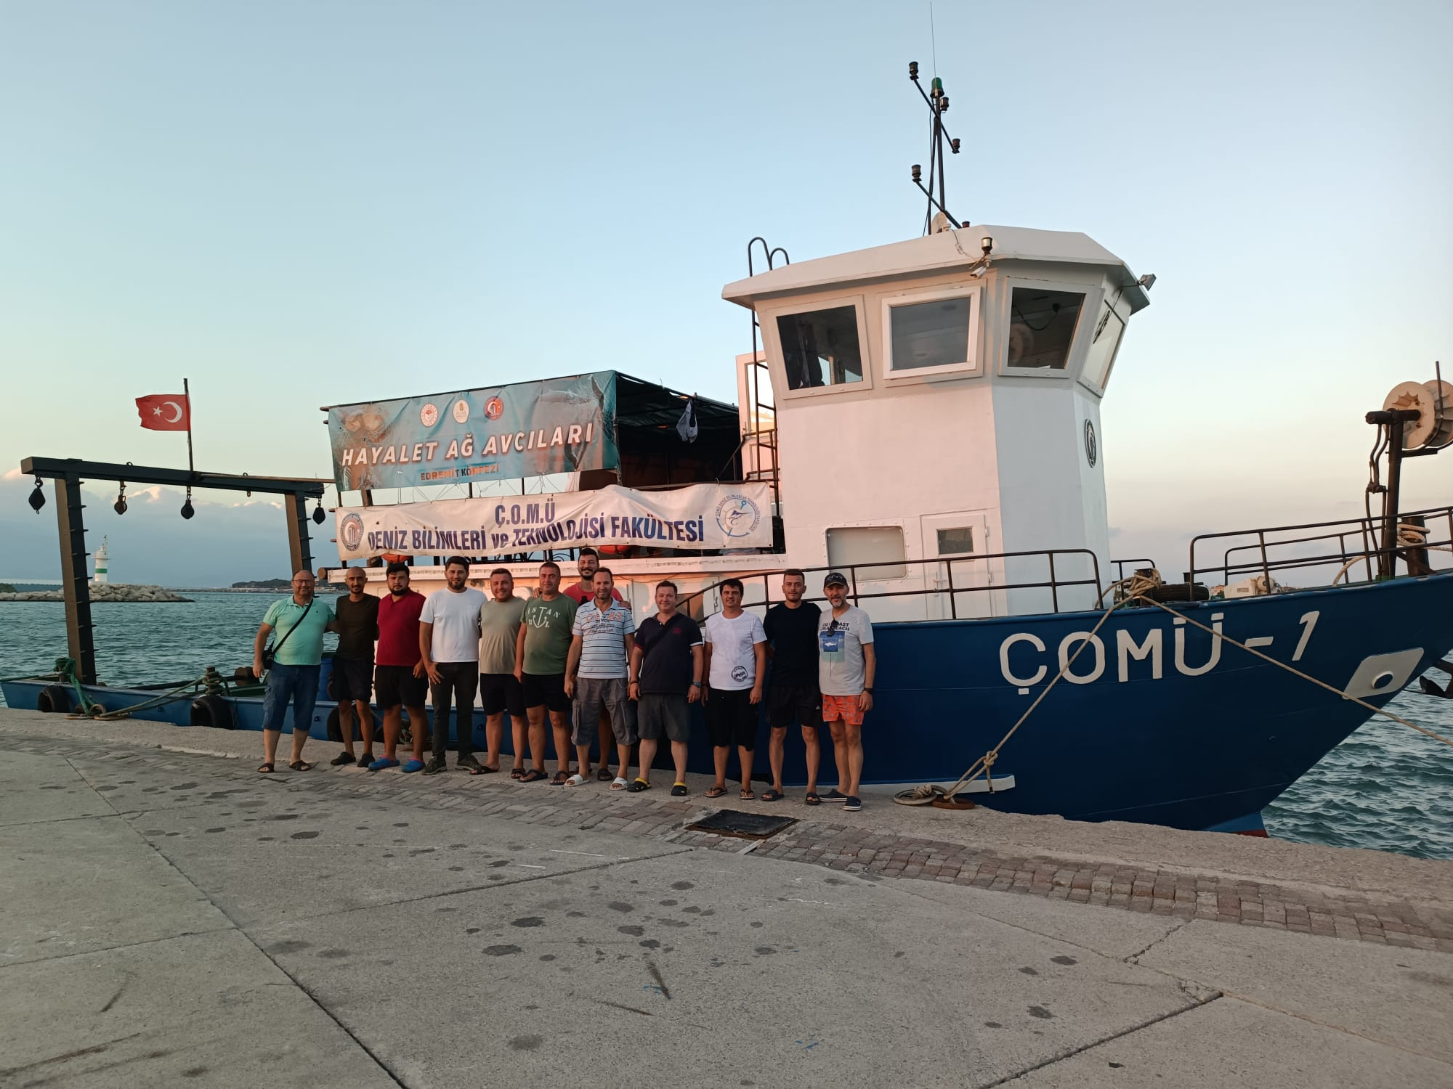
Ghost Net Hunters, Edremit Bay (Ongoing project)
A cooperation protocol was signed between Çanakkale Onsekiz Mart University and Balıkesir Metropolitan Municipality. Within the scope of this protocol, the Underwater Research and Application Center, on behalf of the University, together with the Faculty of Marine Sciences and Technology, started the project named "Ghost Net Hunters, Edremit" in September 2022. Within the scope of this project, a similar activity will be carried out in the Edremit Bay as in the Marmara Sea.

Slide 8
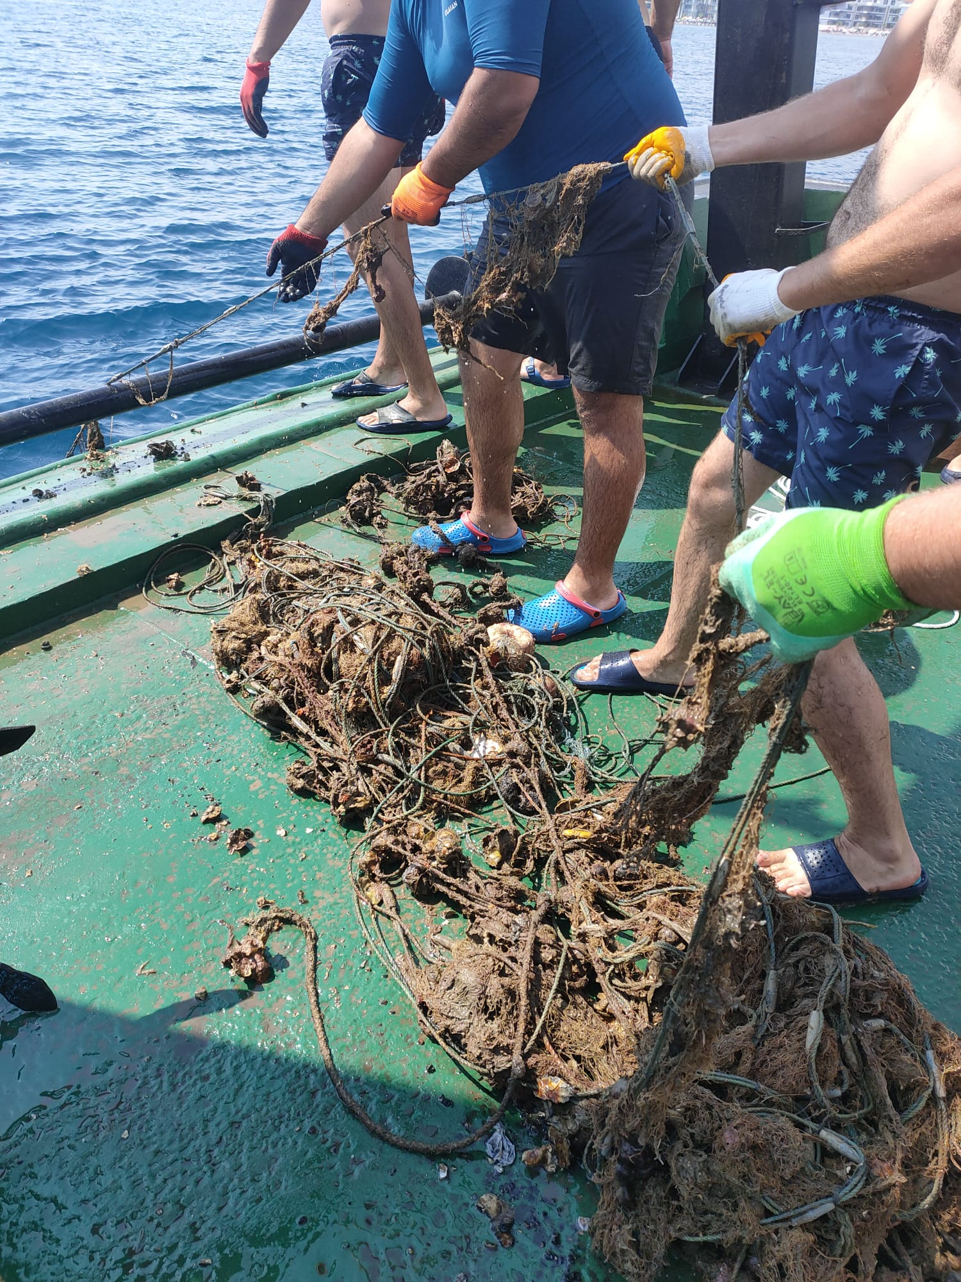
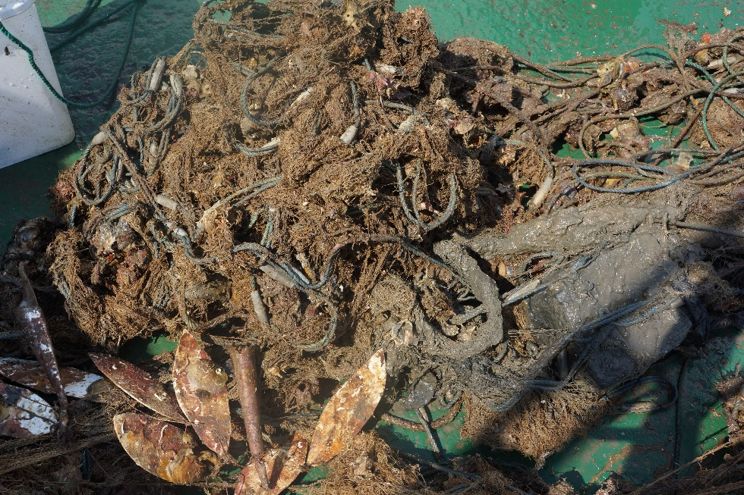
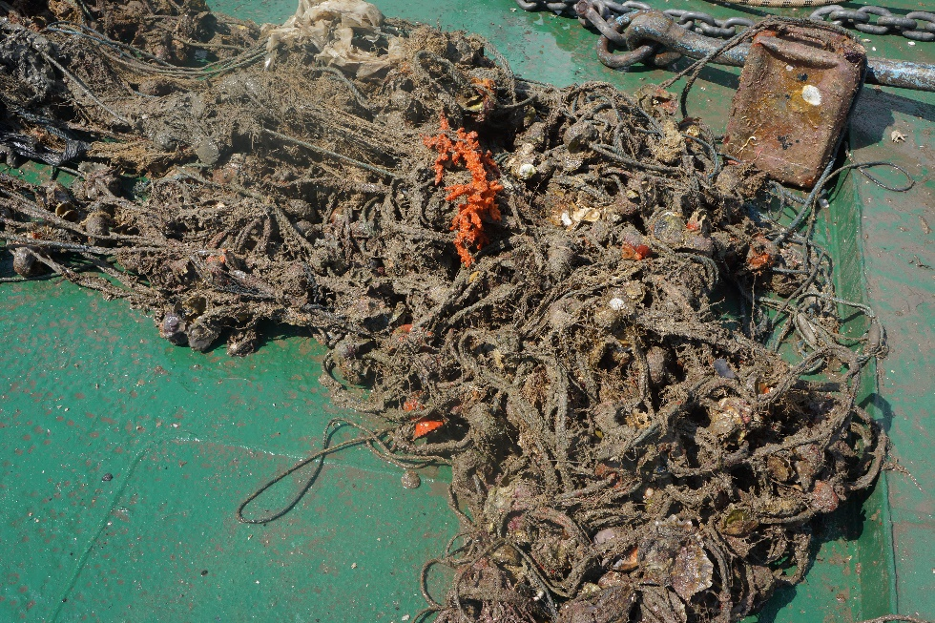
Ghost Net Hunters, Edremit Bay (Ongoing project)
Within the scope of this project, the process of cleaning the ghost nets remaining on the artificial reefs in the Altınoluk town, which was carried out by the Ministry of Agriculture and Forestry in order to improve fisheries, has started. Within the scope of the project, approximately 700 m of lost gillnets were removed from the reefs.

Slide 9
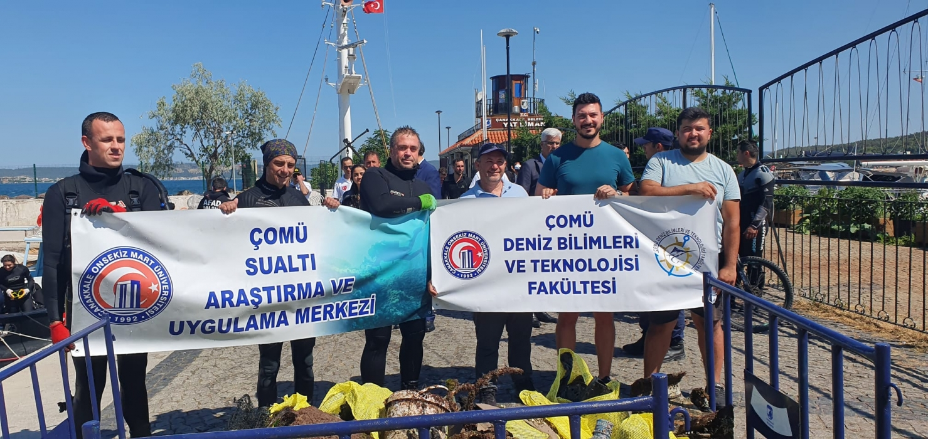
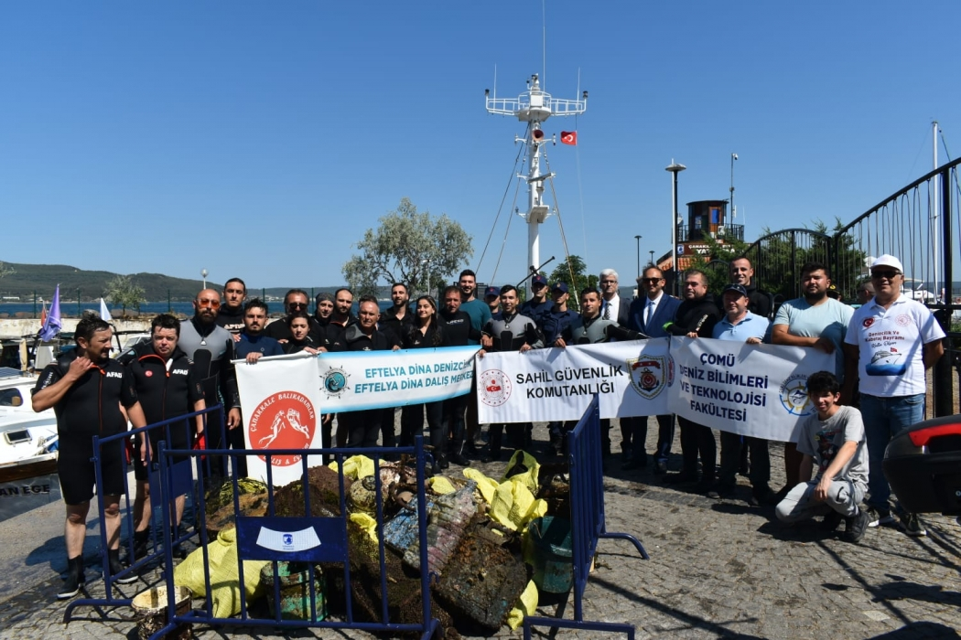
June 1, 2022 World Environment Week
Participation was made in the port cleaning event held at Çanakkale Marina within the scope of World Environment Week.

Slide 10
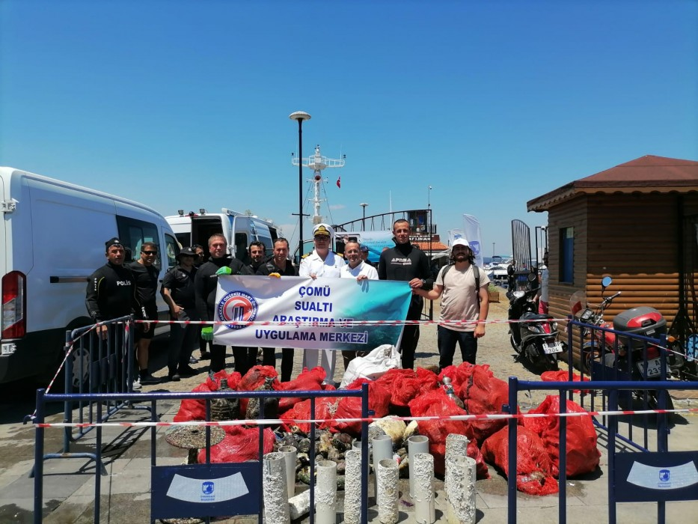
Participation in 1 July 2022 Cabotage Day Activities was provided
As every year, we participated in the cabotage festival events this year and seabed cleaning was carried out in the Koltuk Harbor area in the Çanakkale Marina region.

Slide 11
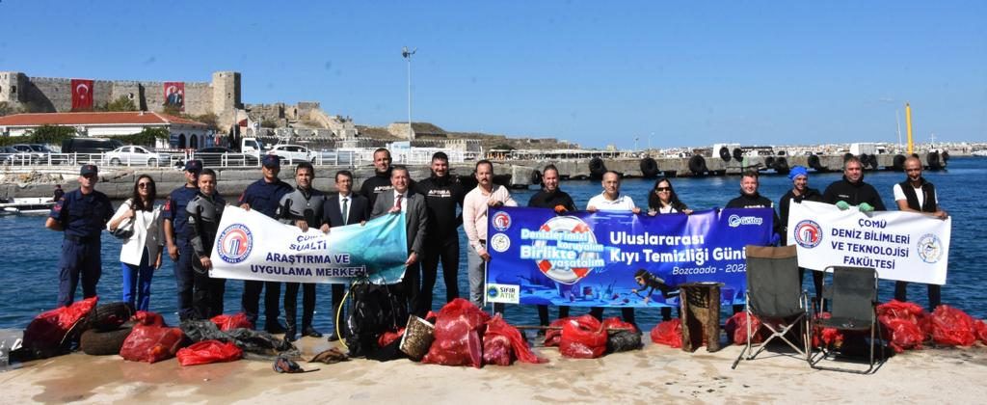
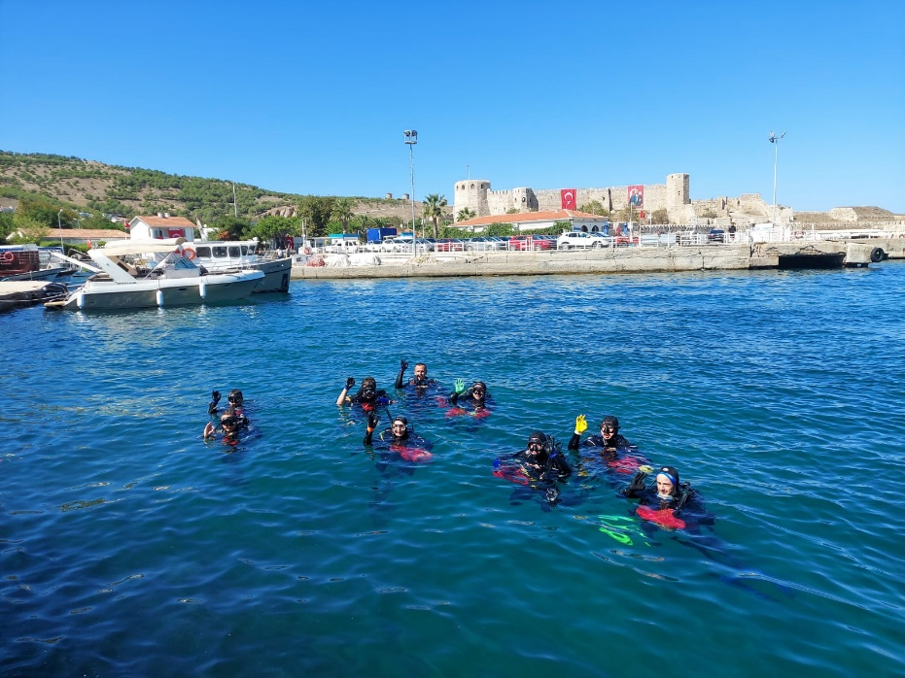
19 September International Coastal Cleaning Day Bozcaada Port Cleaning
An underwater cleaning activity was held at Bozcaada Port within the scope of the 19 September International Coastal Cleaning events.

Slide 12
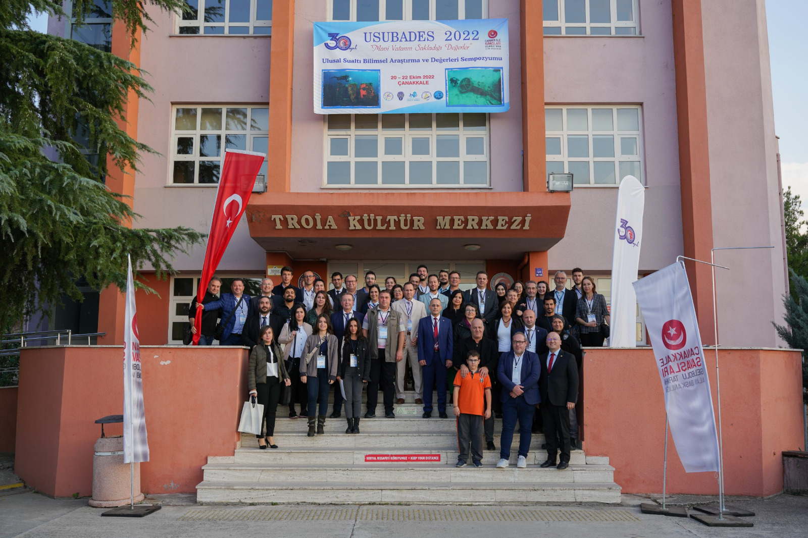
National Underwater Scientific Research and Values Symposium (USUBADES) was Held
The symposium, whose organizing committee included our center, was held between 20-22 October 2022.

Slide 13
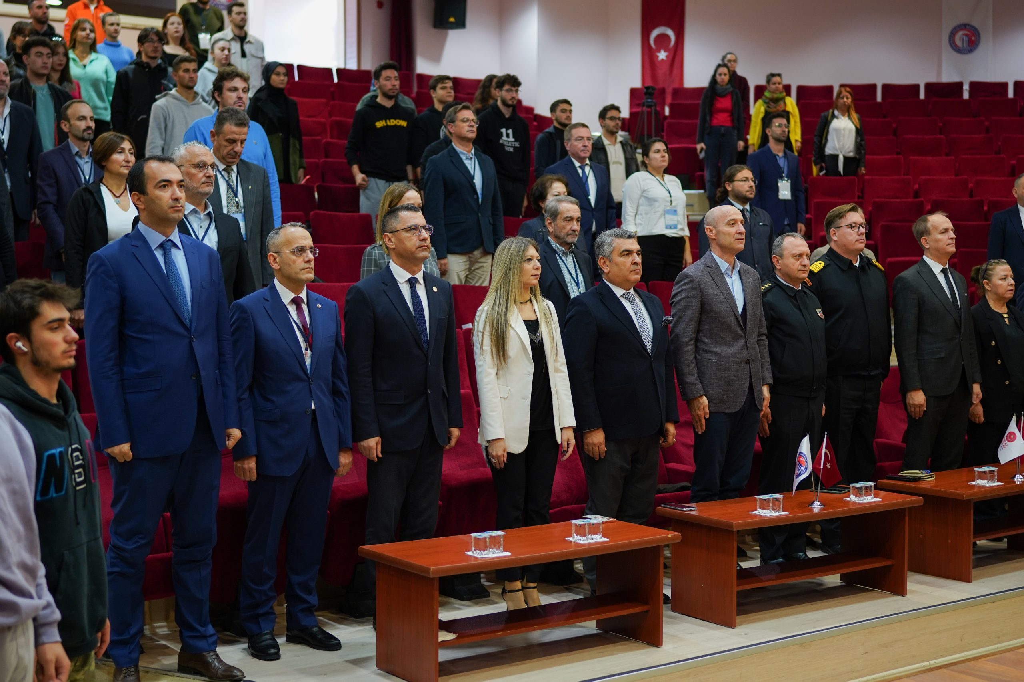
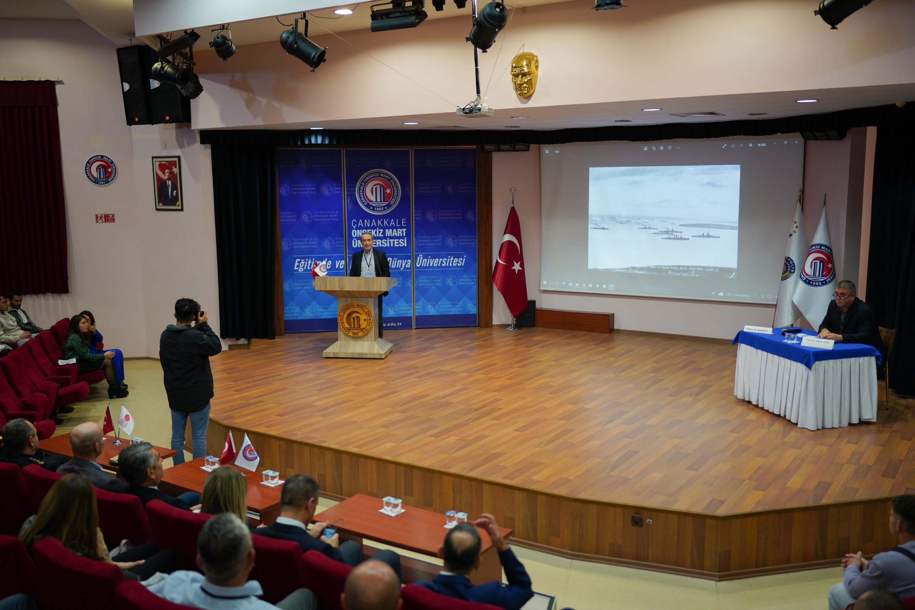
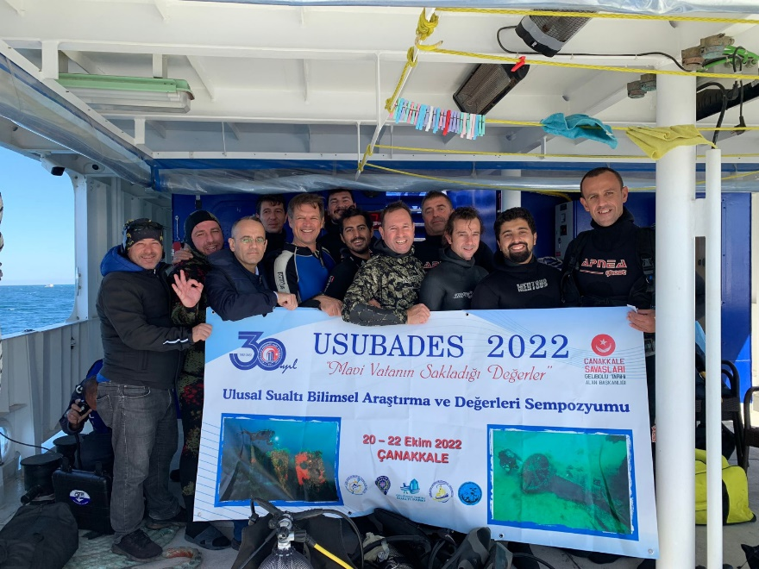
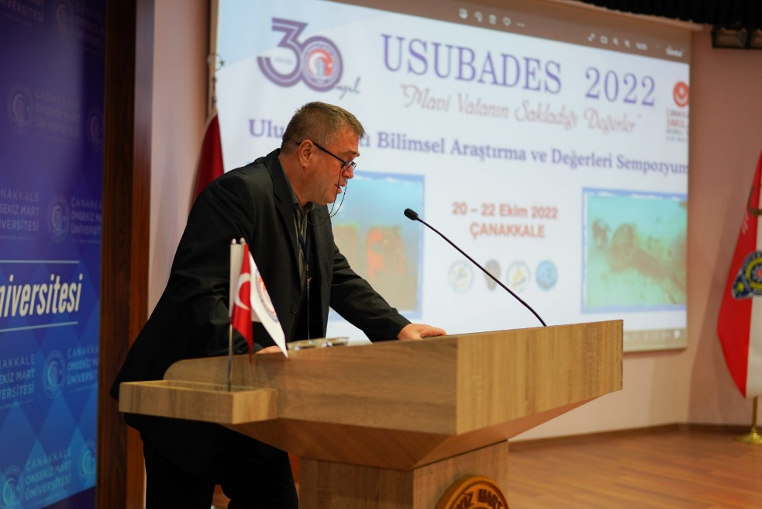
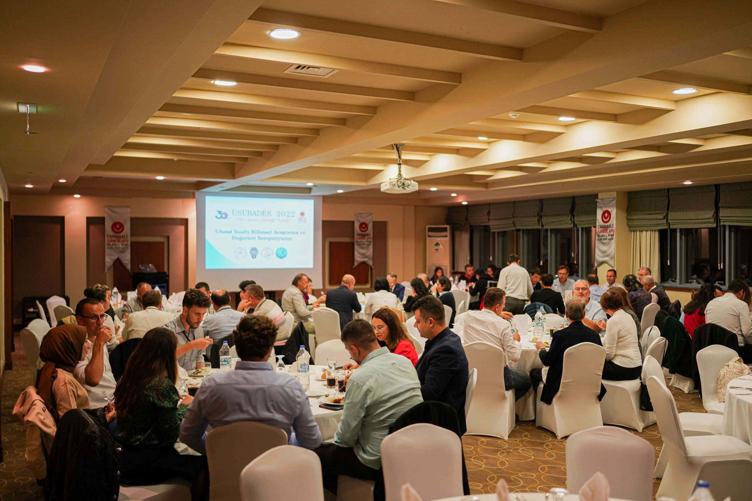
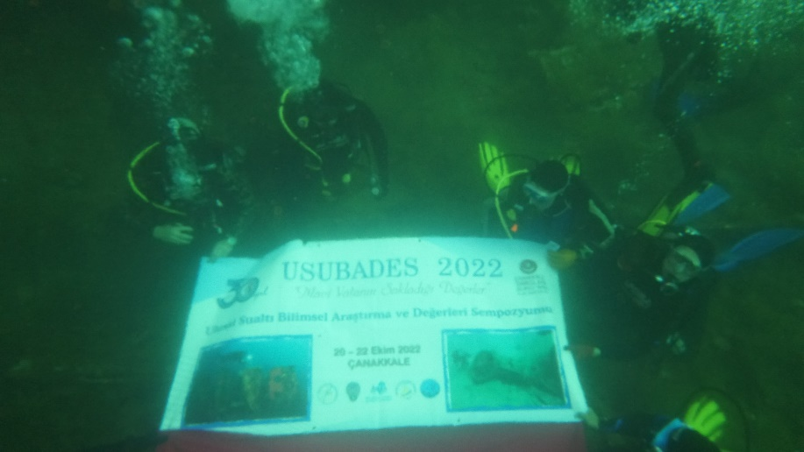
USUBADES 2022

