Slide 1
Underwater Research and Application Center
2022 Activity Presentation

Slide 2
Activities carried out by our center in 2023
Our center has completed the project named "Ghost Net Hunters Edremit Bay", which started in 2022 within the scope of the cooperation protocol signed between Balıkesir Metropolitan Municipality and our University in 2023. In addition, our center has also carried out the revolving fund project named "Detecting Pinna nobilis (Pinna nobilis) in the Dredging Area for Docking in the Gallipoli Shipyard and Transporting them to Safe Areas". In addition, as every year, it also participated in the sea cleaning event held on July 1 Cabotage Festival. He contributed to the awareness project titled "Ghost nets and invasive species" of the Resource Management Department of the Ministry of Agriculture and Forestry, General Directorate of Fisheries and Aquaculture, by making presentations in two different provinces.

Slide 3
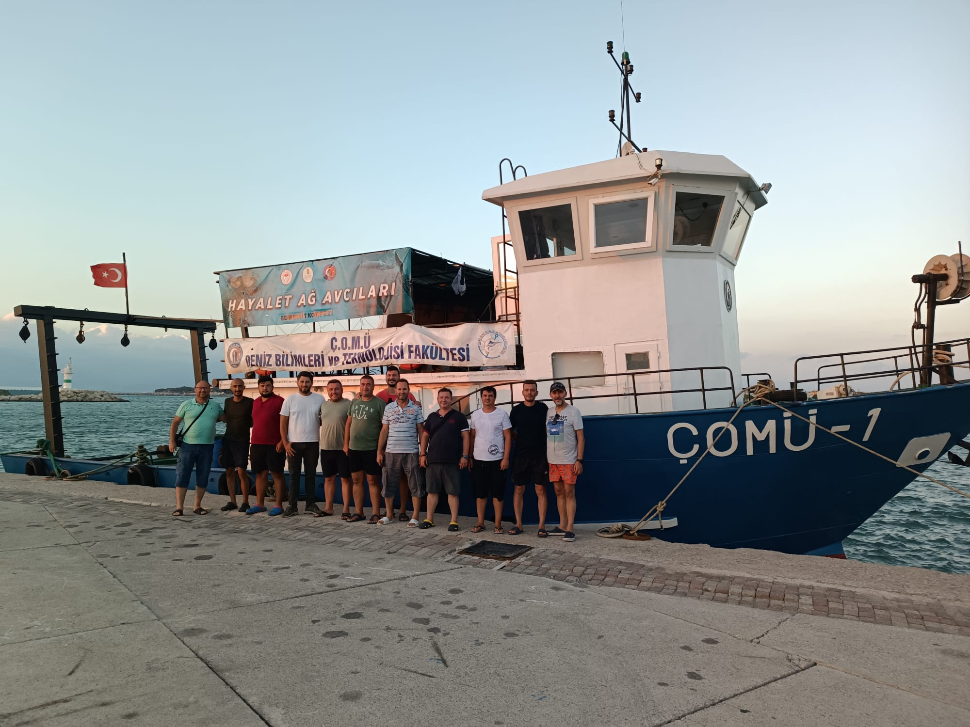
Ghost Net Hunters, Edremit Bay
A cooperation protocol was signed between Çanakkale Onsekiz Mart University and Balıkesir Metropolitan Municipality in July 2021. Within the scope of this protocol, the Underwater Research and Application Center, on behalf of the University, together with the Faculty of Marine Sciences and Technology, started the project named "Ghost Net Hunters, Edremit" in September 2022, and this project was completed as of October 2023.

Slide 4
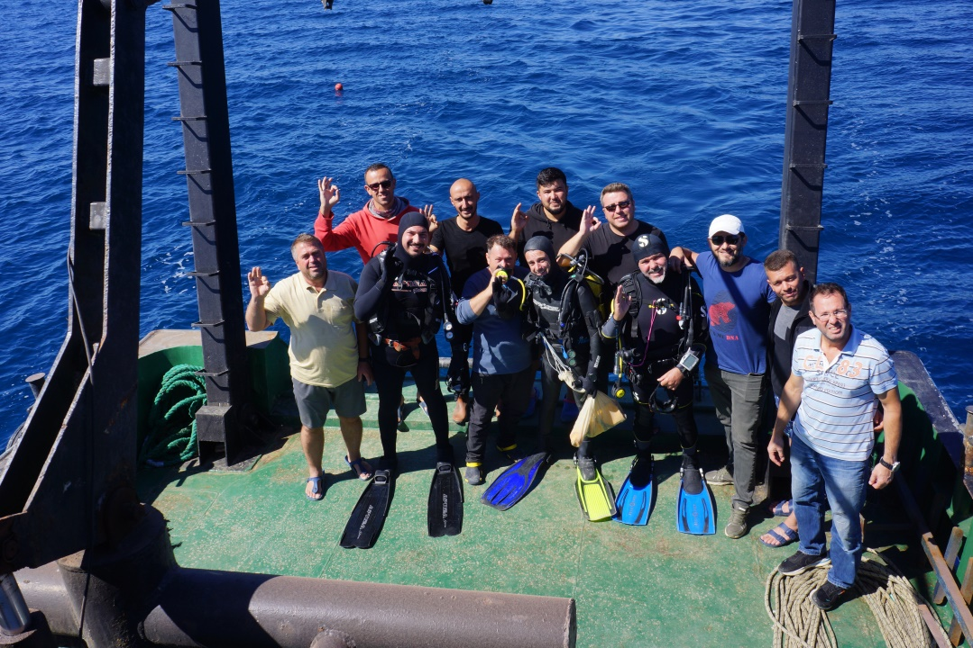
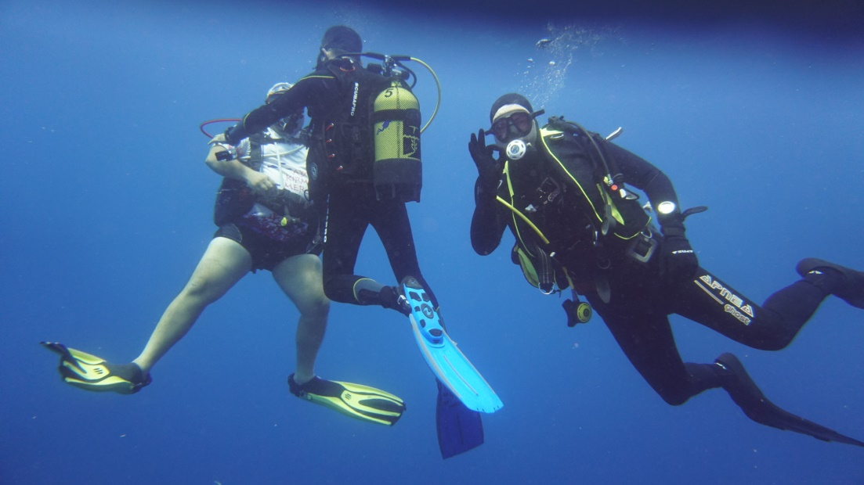
Ghost Net Hunters, Edremit Bay
Within the scope of the project, dives were carried out around the artificial reef areas, natural reef areas and Ayvalık islands placed by the Ministry of Agriculture and Forestry in the Edremit Bay, and the fishing gear and parts left on the ground were cleaned and removed from the environment. In addition to the participation of our entire Central board of directors in the project, our PhD and master's students also participated. In this way, the diving training of our students continued to be reinforced.

Slide 5
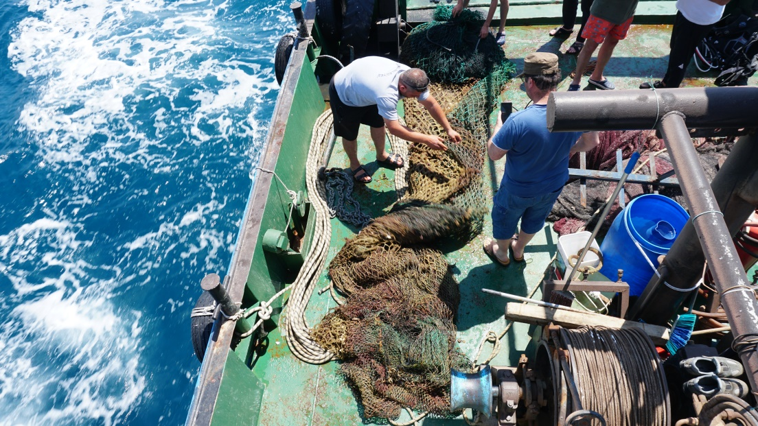
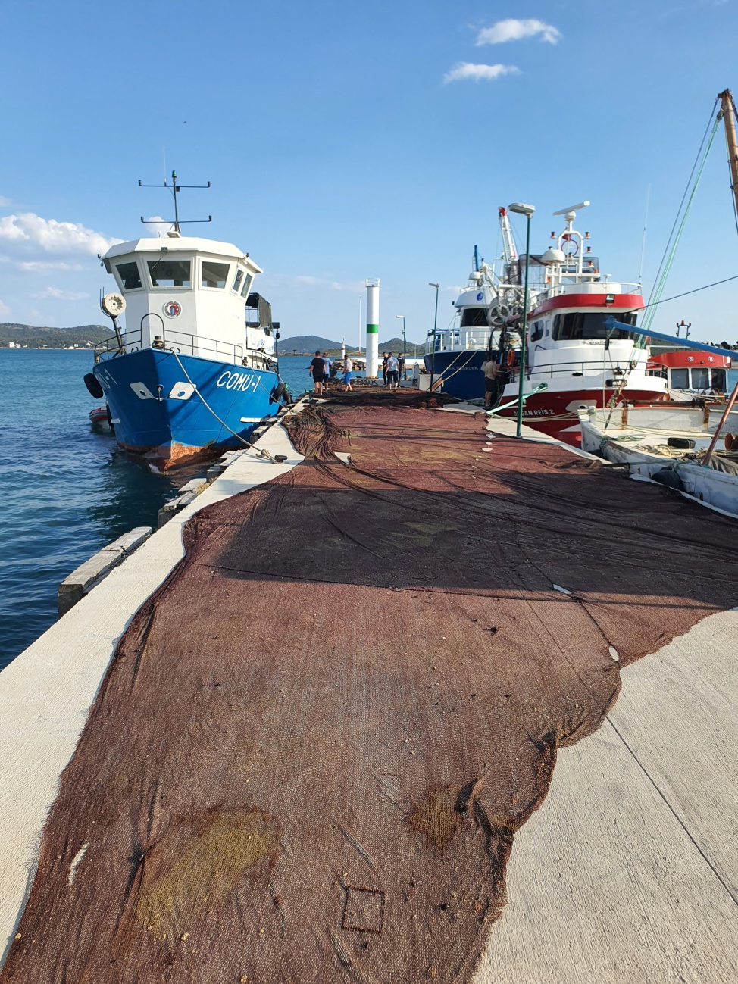
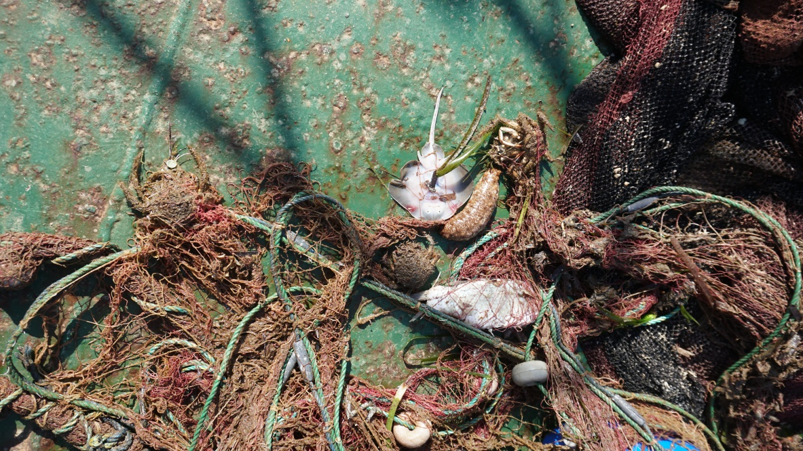
Ghost Net Hunters, Edremit Bay Project
Trawl bag lifted off the coast of Gömeç Port
An abandoned gillnet removed from the coast of the Ayvalık Hakkıbey Peninsula. Live and dead fish were found on it.
Ayvalık Güneş adası sığlığından denizden kaldırılan gırgır ağı parçası (Yer: Alibey adası Sahil Güvenlık iskelesi)

Slide 6
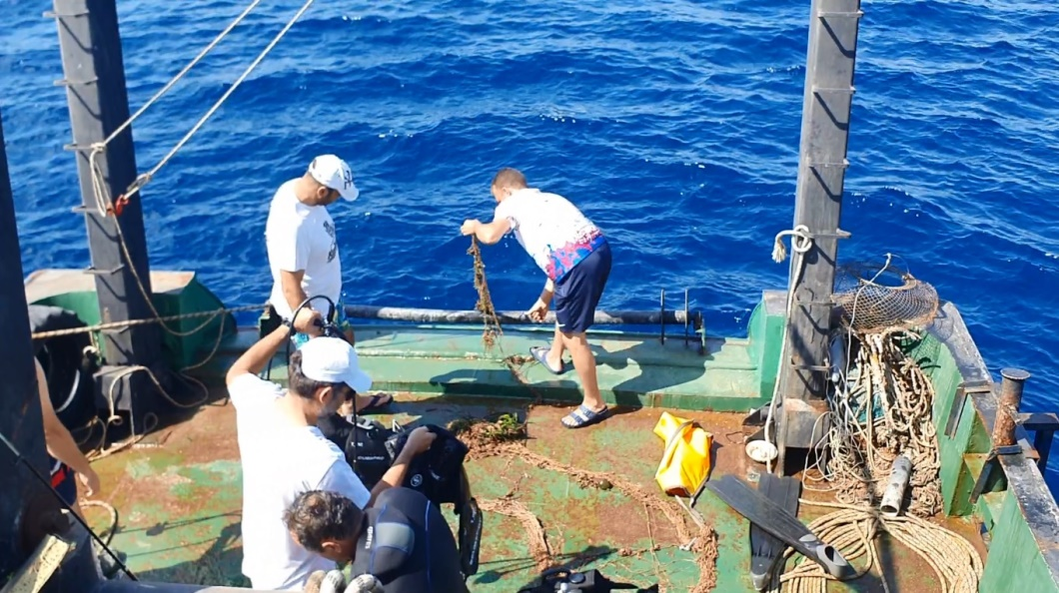
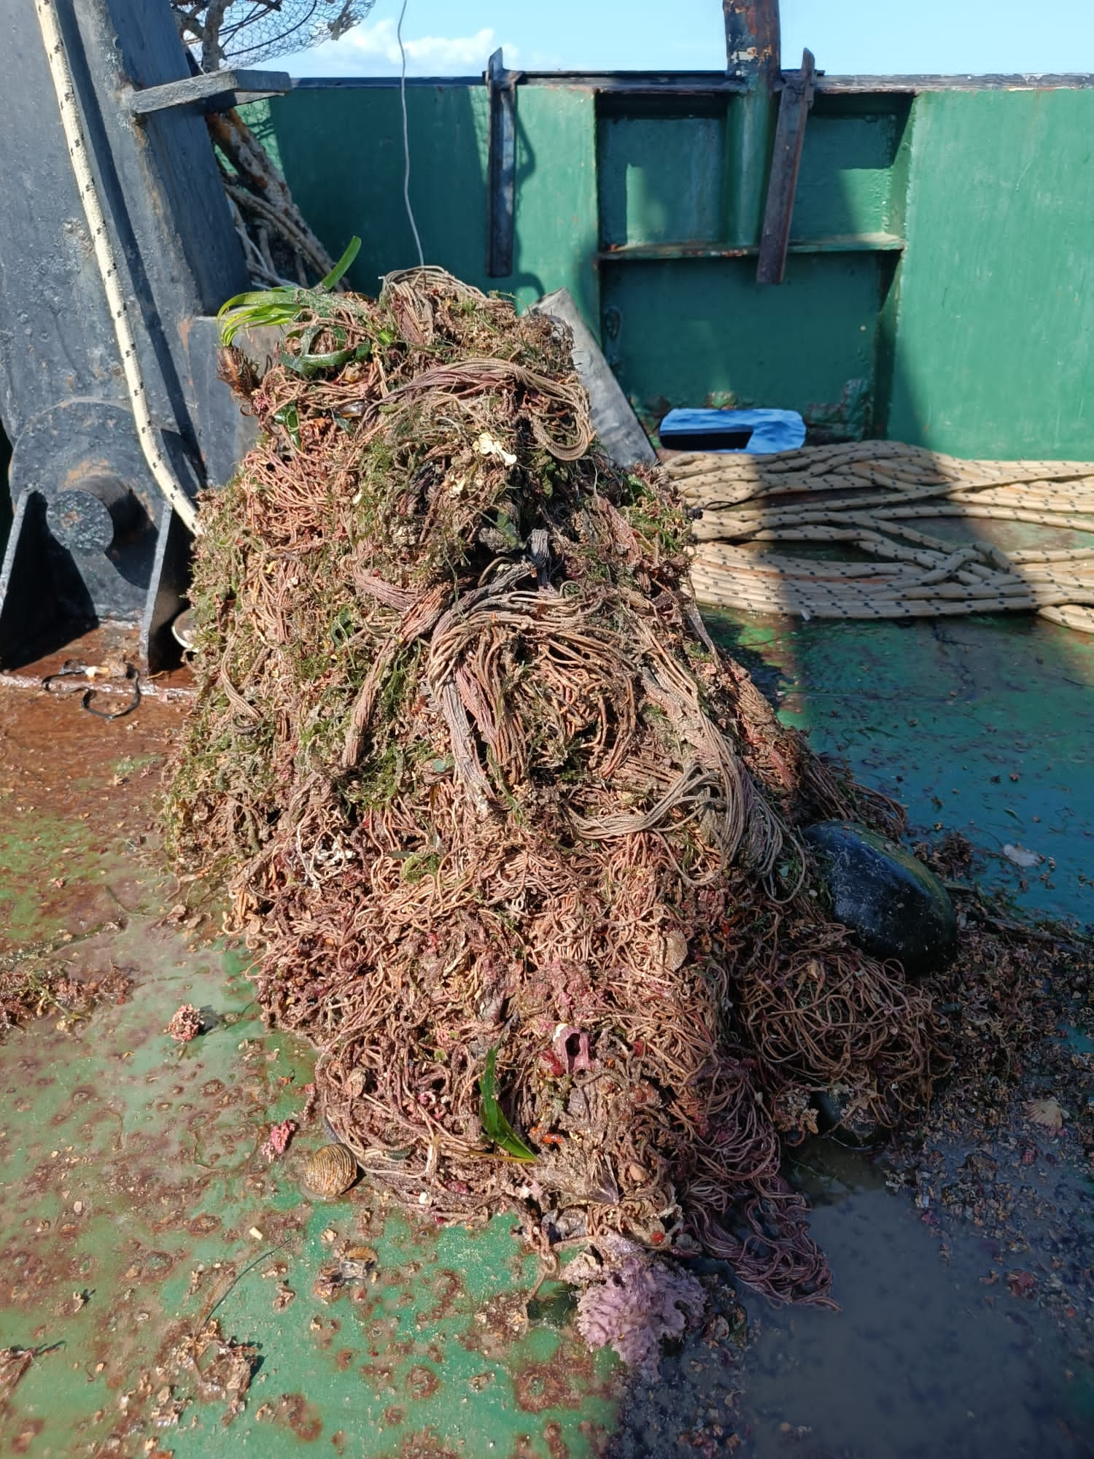
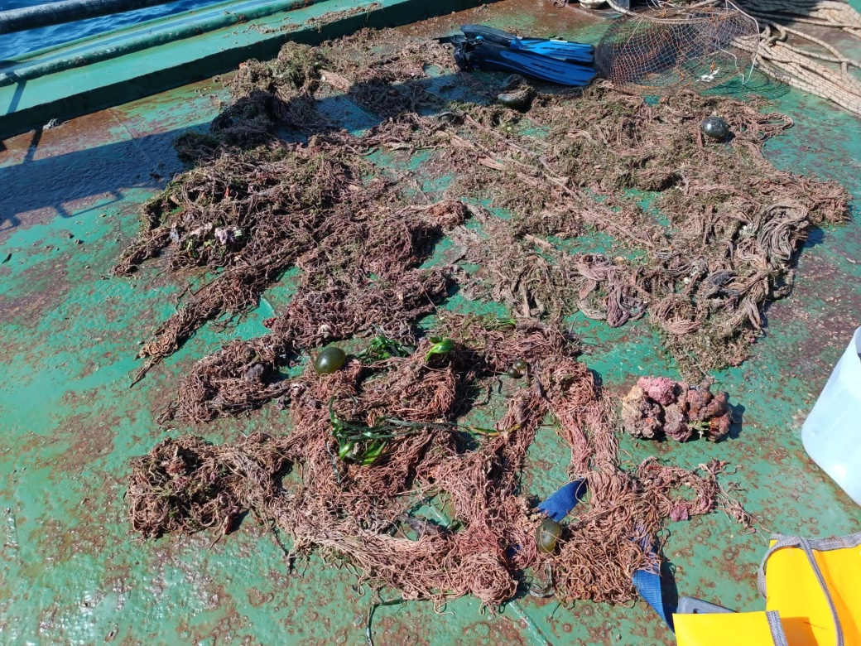
Ghost Net Hunters, Edremit Bay Project
Trata net fragments recovered from the bottom from a depth of 35 m from the Ayvalık Patriciya region

Slide 7
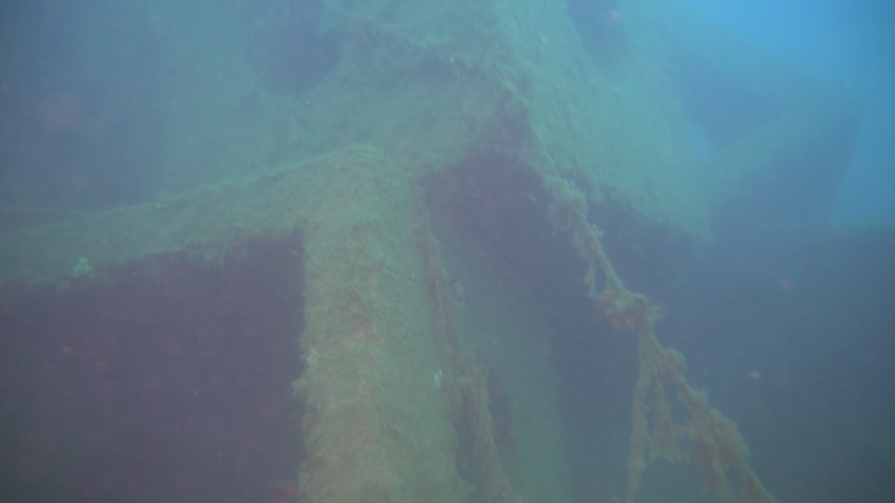
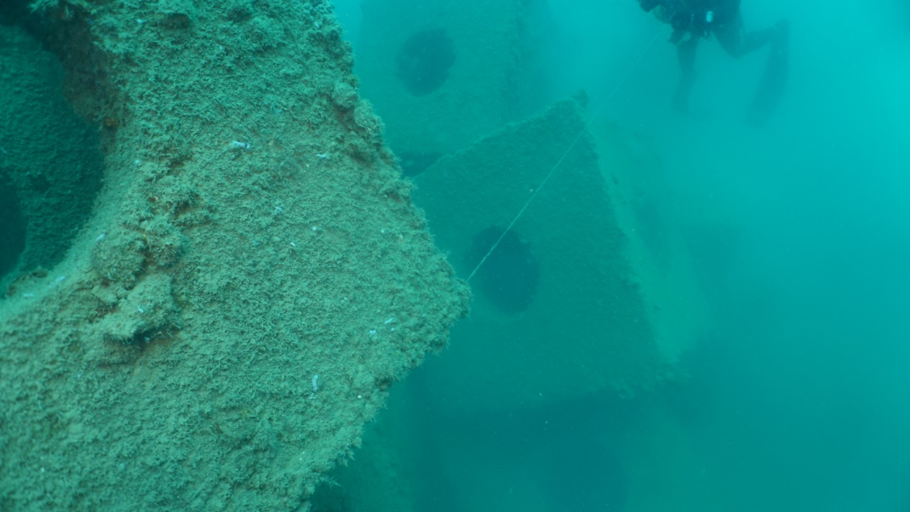
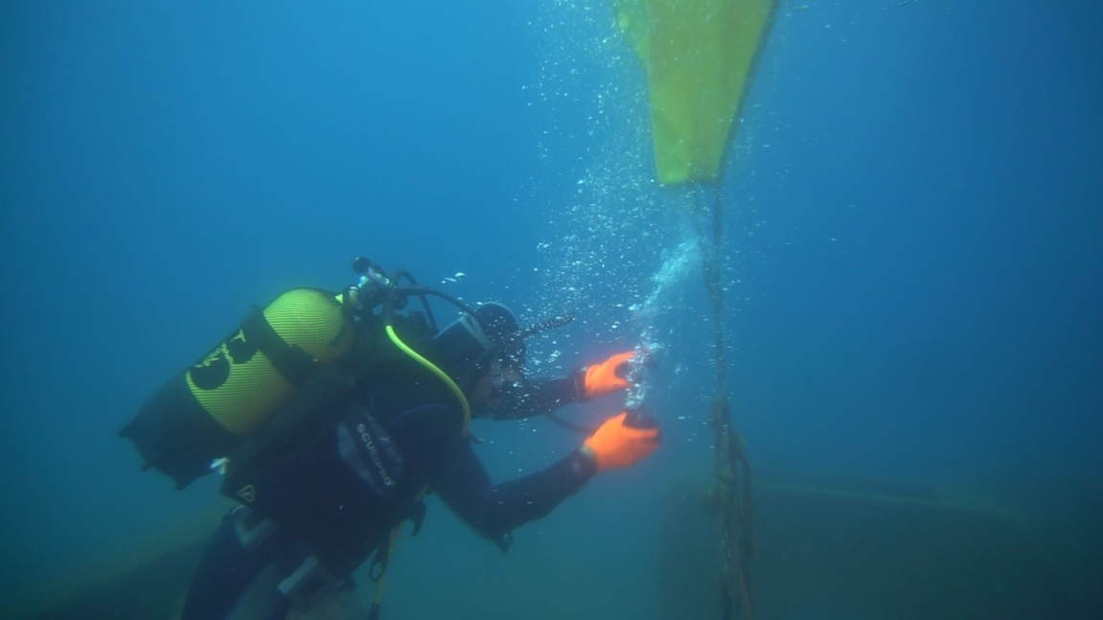
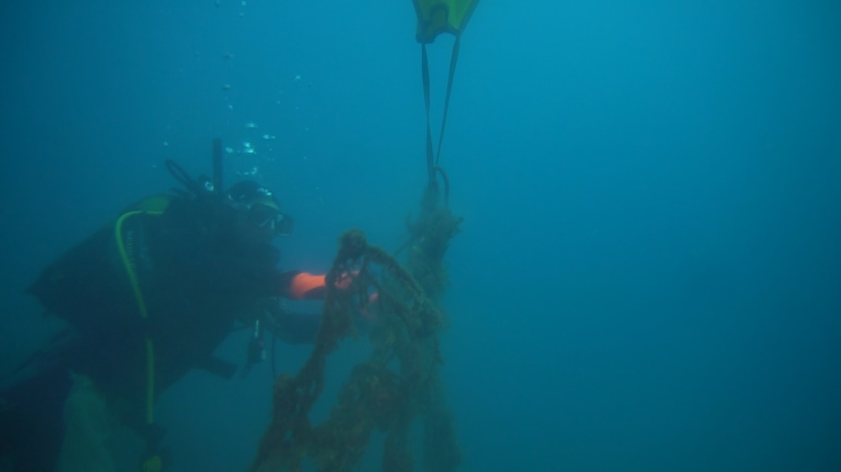
Ghost Net Hunters, Edremit Bay Project
Within the scope of the project, the artificial reef areas deployed by the Ministry of Agriculture and Forestry between Altınoluk and Akçay were checked and the lost fishing gear found was removed from the reefs.

Slide 8
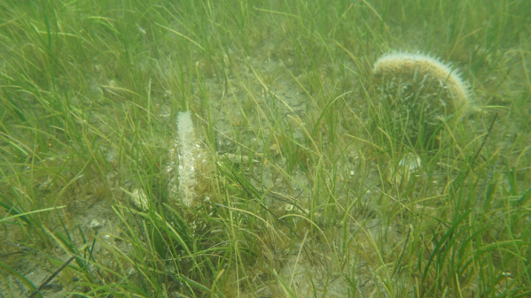
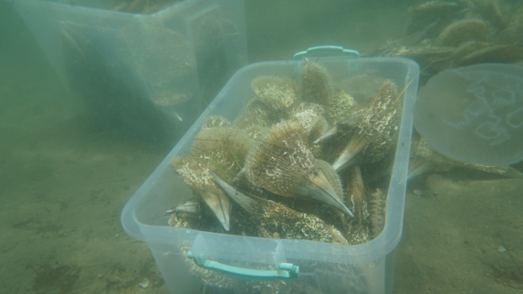
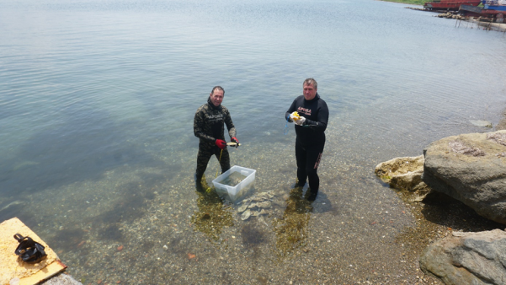
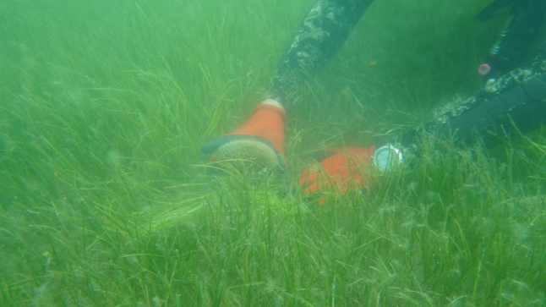
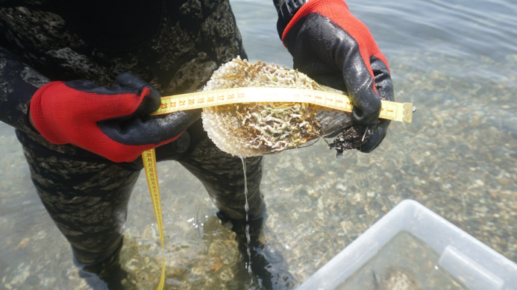
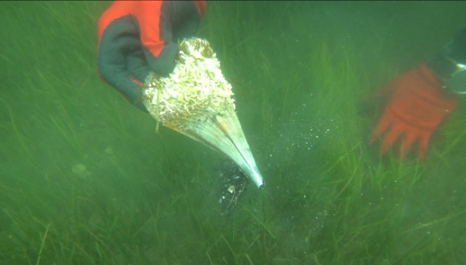
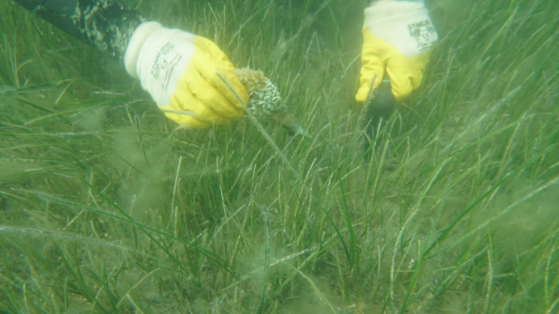
Project for Detecting Pinnas (Pinna nobilis) in the Dredging Area for Drydocking in Gelibolu Shipyard and Transporting them to Safe Areas
Dredging and deepening activities will be carried out in the sea area, next to the pier of the Gelibolu shipyard located in the Gelibolu district of Çanakkale province. In the content of the previously prepared and submitted EIA report, the academics who prepared the report stated that the endangered species of pina (Pinna nobilis), a bivalvia species, was found in the area to be surveyed. This project aimed to transport the pinas alive to a safe area before the dredging and deepening works began.
Within the scope of the project, academicians of our center safely transported 319 pina individuals from the dredging area and shore of the Gelibolu Shipyard to their new places.
Pina (Pinna nobilis)

Slide 9
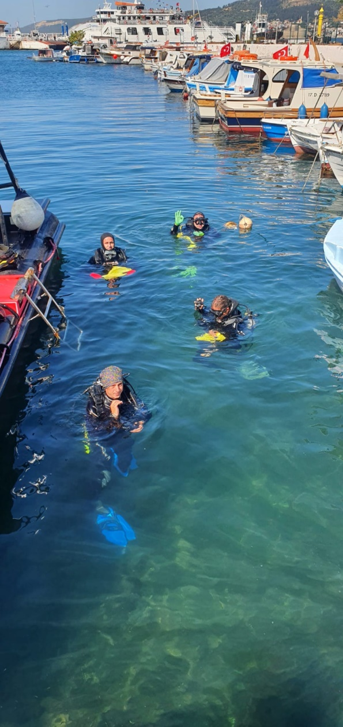
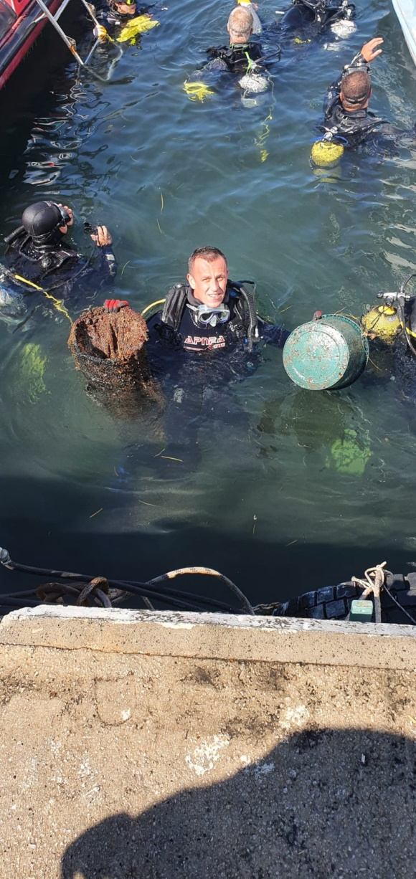
1 July 2023 Cabotage Day Events
Participation was made in the July 1st Cabotage Day events and seabed cleaning was carried out in the Çanakkale marina area.

Slide 10
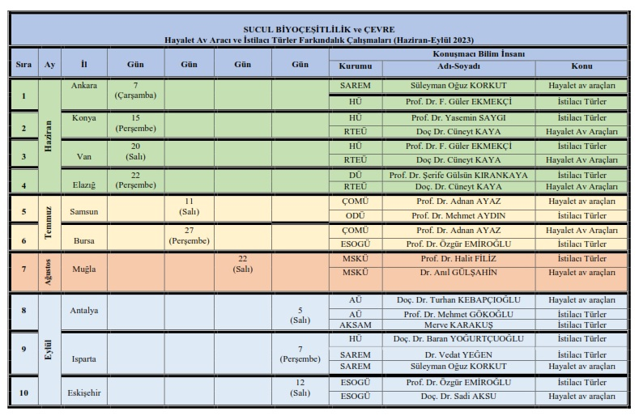
Ghost Nets and Invasive Species Awareness Project
Our center contributed to the Ghost Nets and Invasive Species Awareness Project, which was implemented in 10 provinces by the Resource Management Department of the Ministry of Agriculture and Forestry, General Directorate of Fisheries and Aquaculture, with a presentation titled "Ghost Nets and Their Situation in Turkey" in 2 provinces.

Slide 11
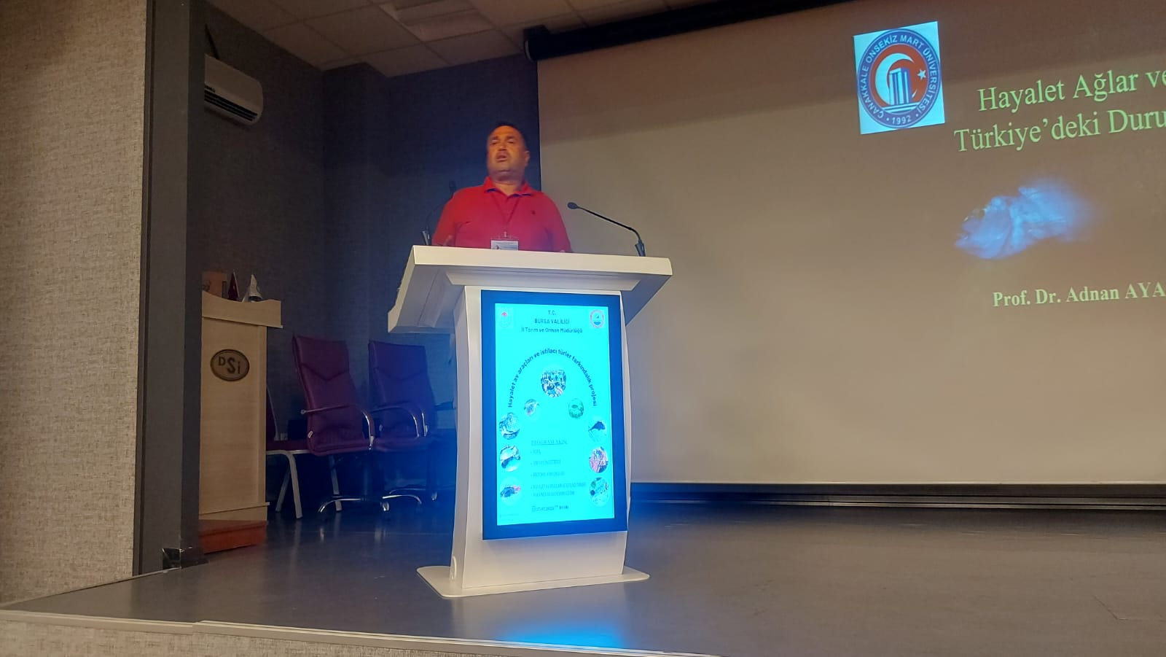
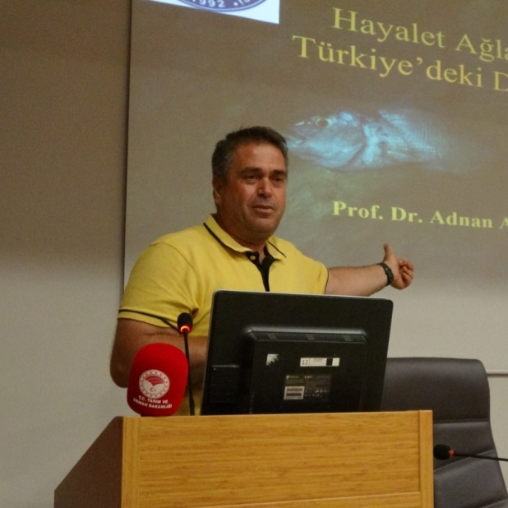
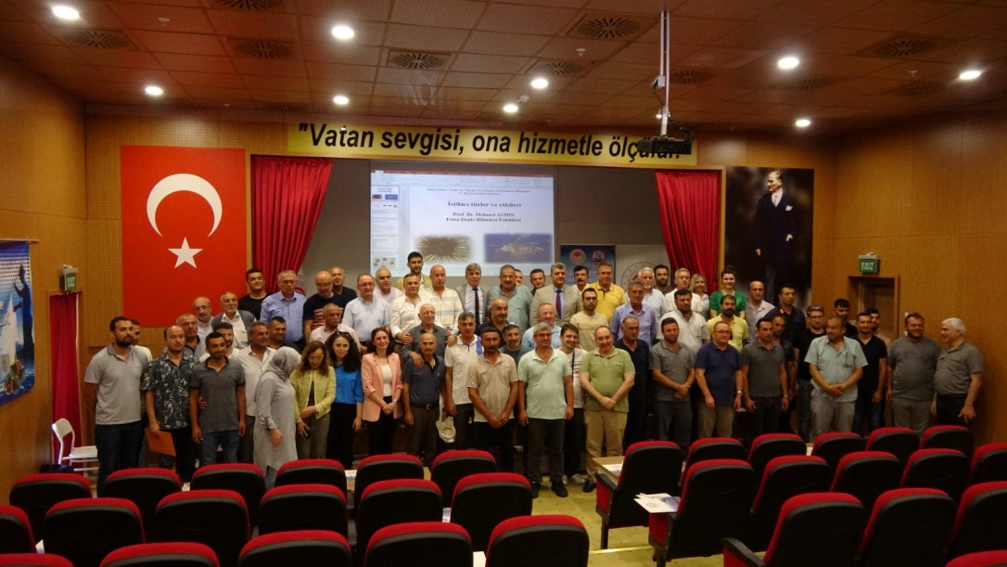
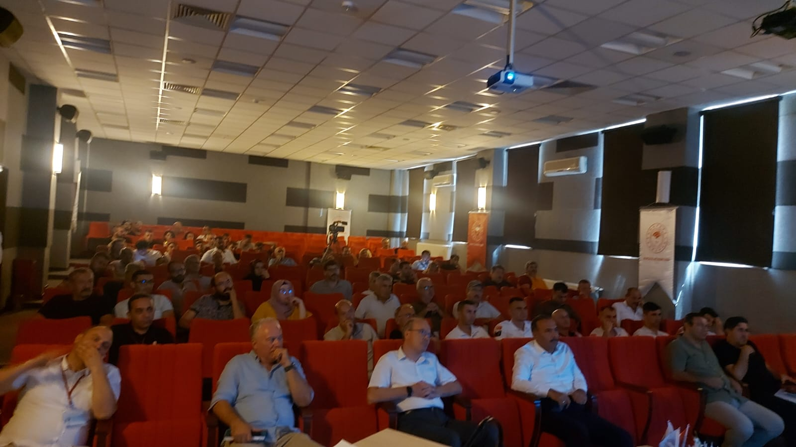
Ghost Nets and Invasive Species Awareness Project
Awareness Project, Samsun
Awareness Project, Bursa

